Slide 1


Introduction to Operating Systems CS 1550
Spring 2023
Sherif Khattab
ksm73@pitt.edu
(Some slides are from Silberschatz, Galvin and Gagne ©2013)

Slide 2
Announcements
Upcoming deadlines
Homework 9 due this Friday
Lab 3 is due on Tuesday 3/28 at 11:59 pm
Project 3 is due Friday 4/7 at 11:59 pm

Slide 3
Previous lecture …
How to simulate page replacement algorithms
FIFO

Slide 4
This lecture …
How to simulate page replacement algorithms
Clock, LRU, OPT

Slide 5
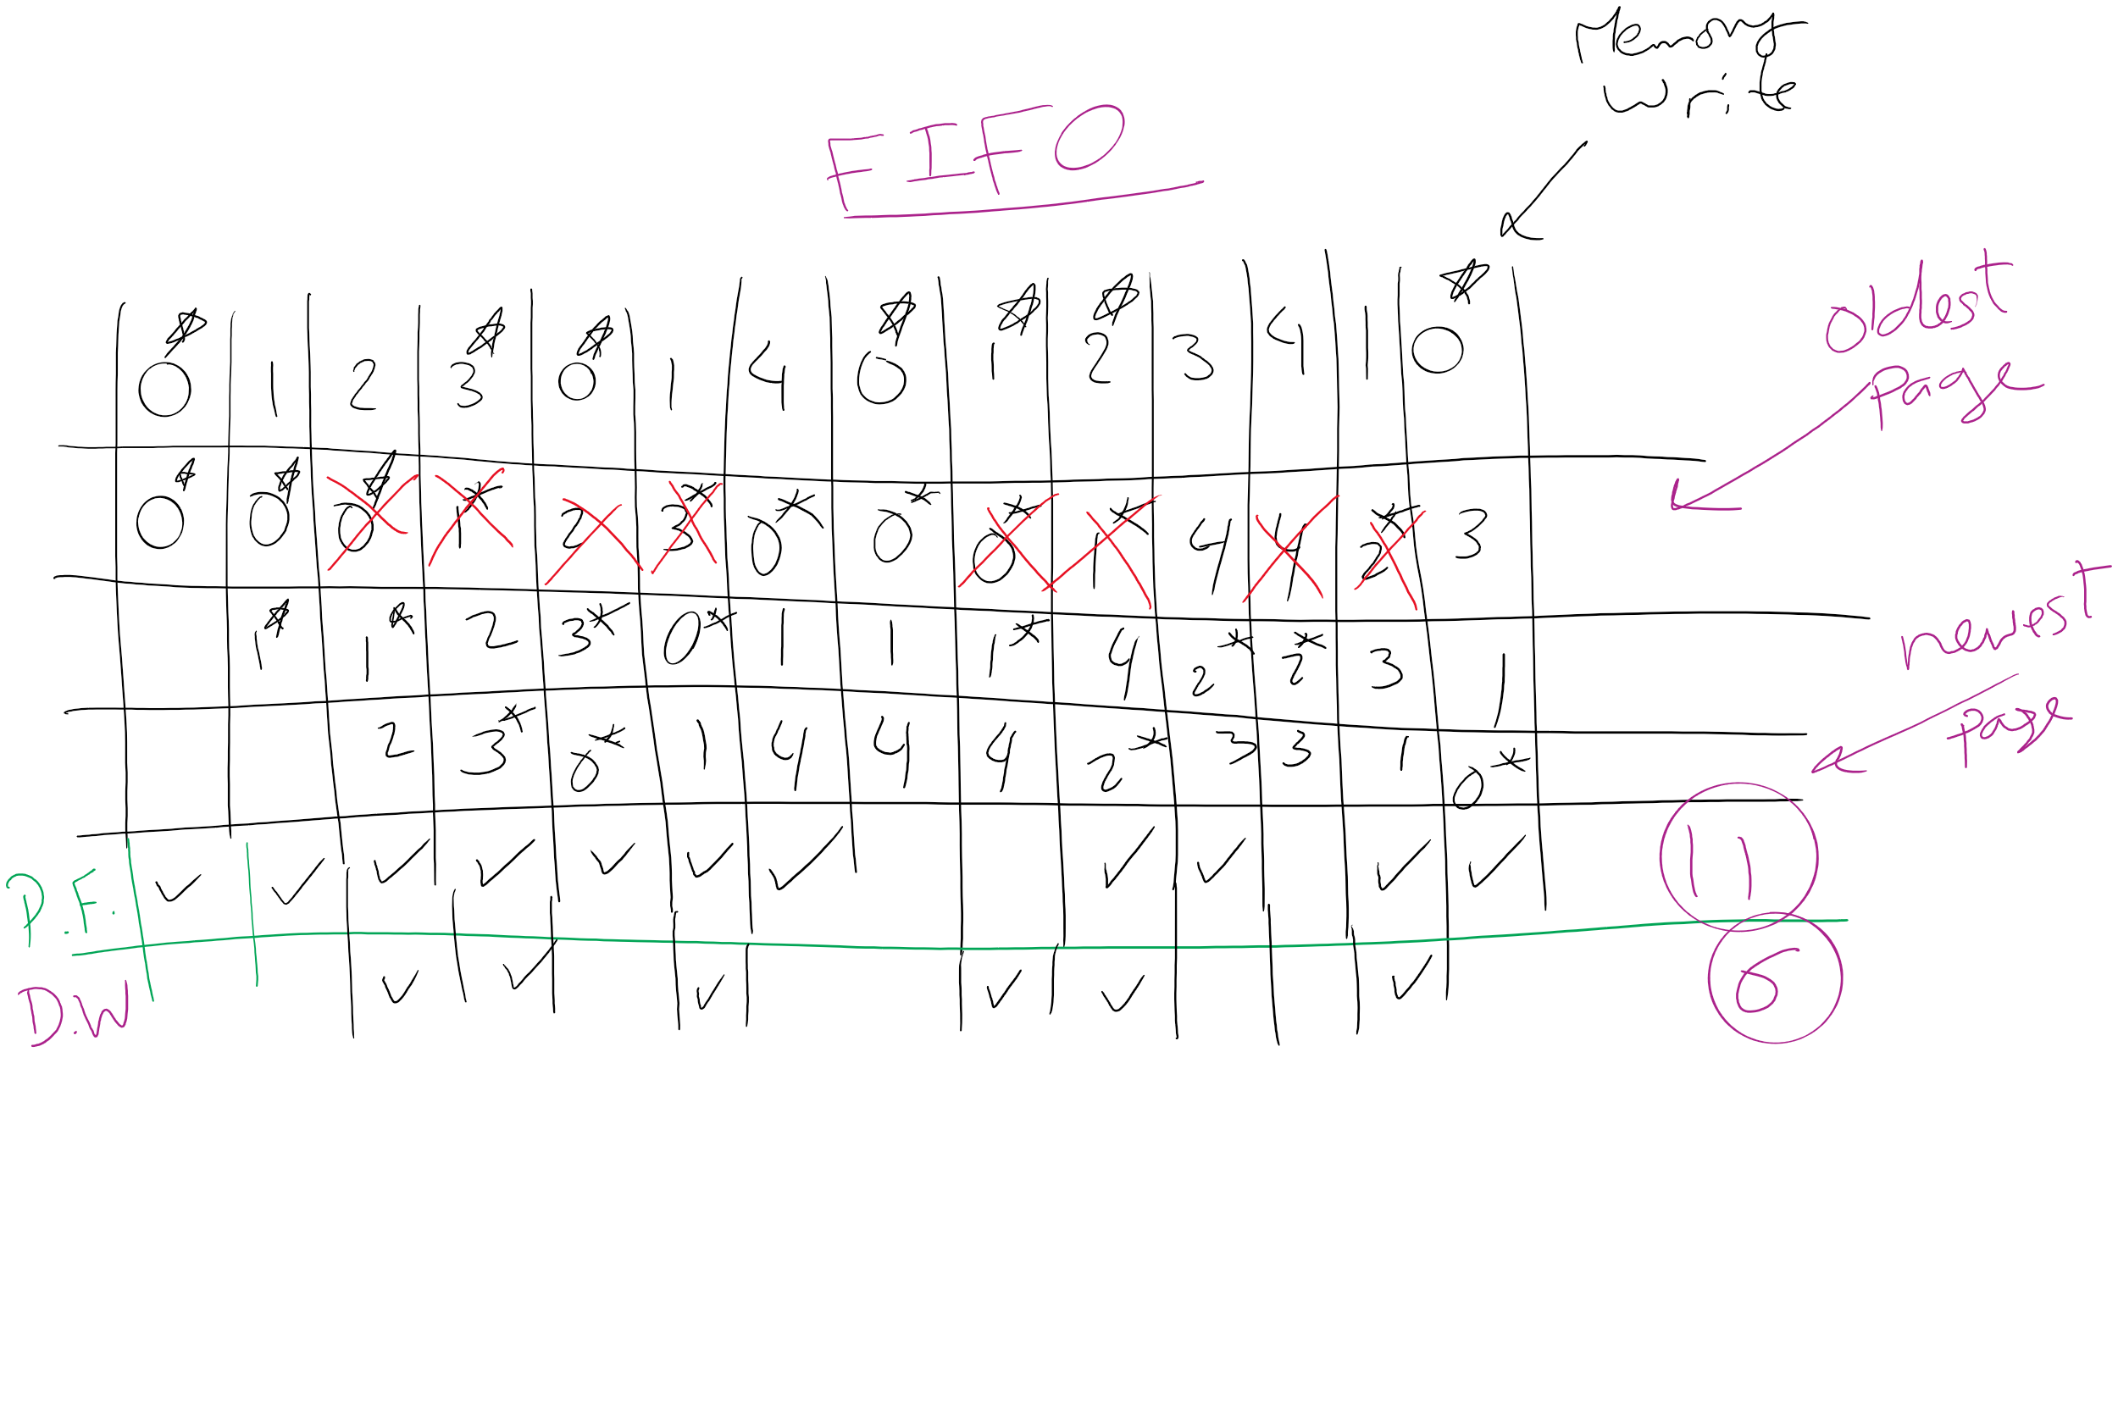
FIFO Example 1

Slide 6
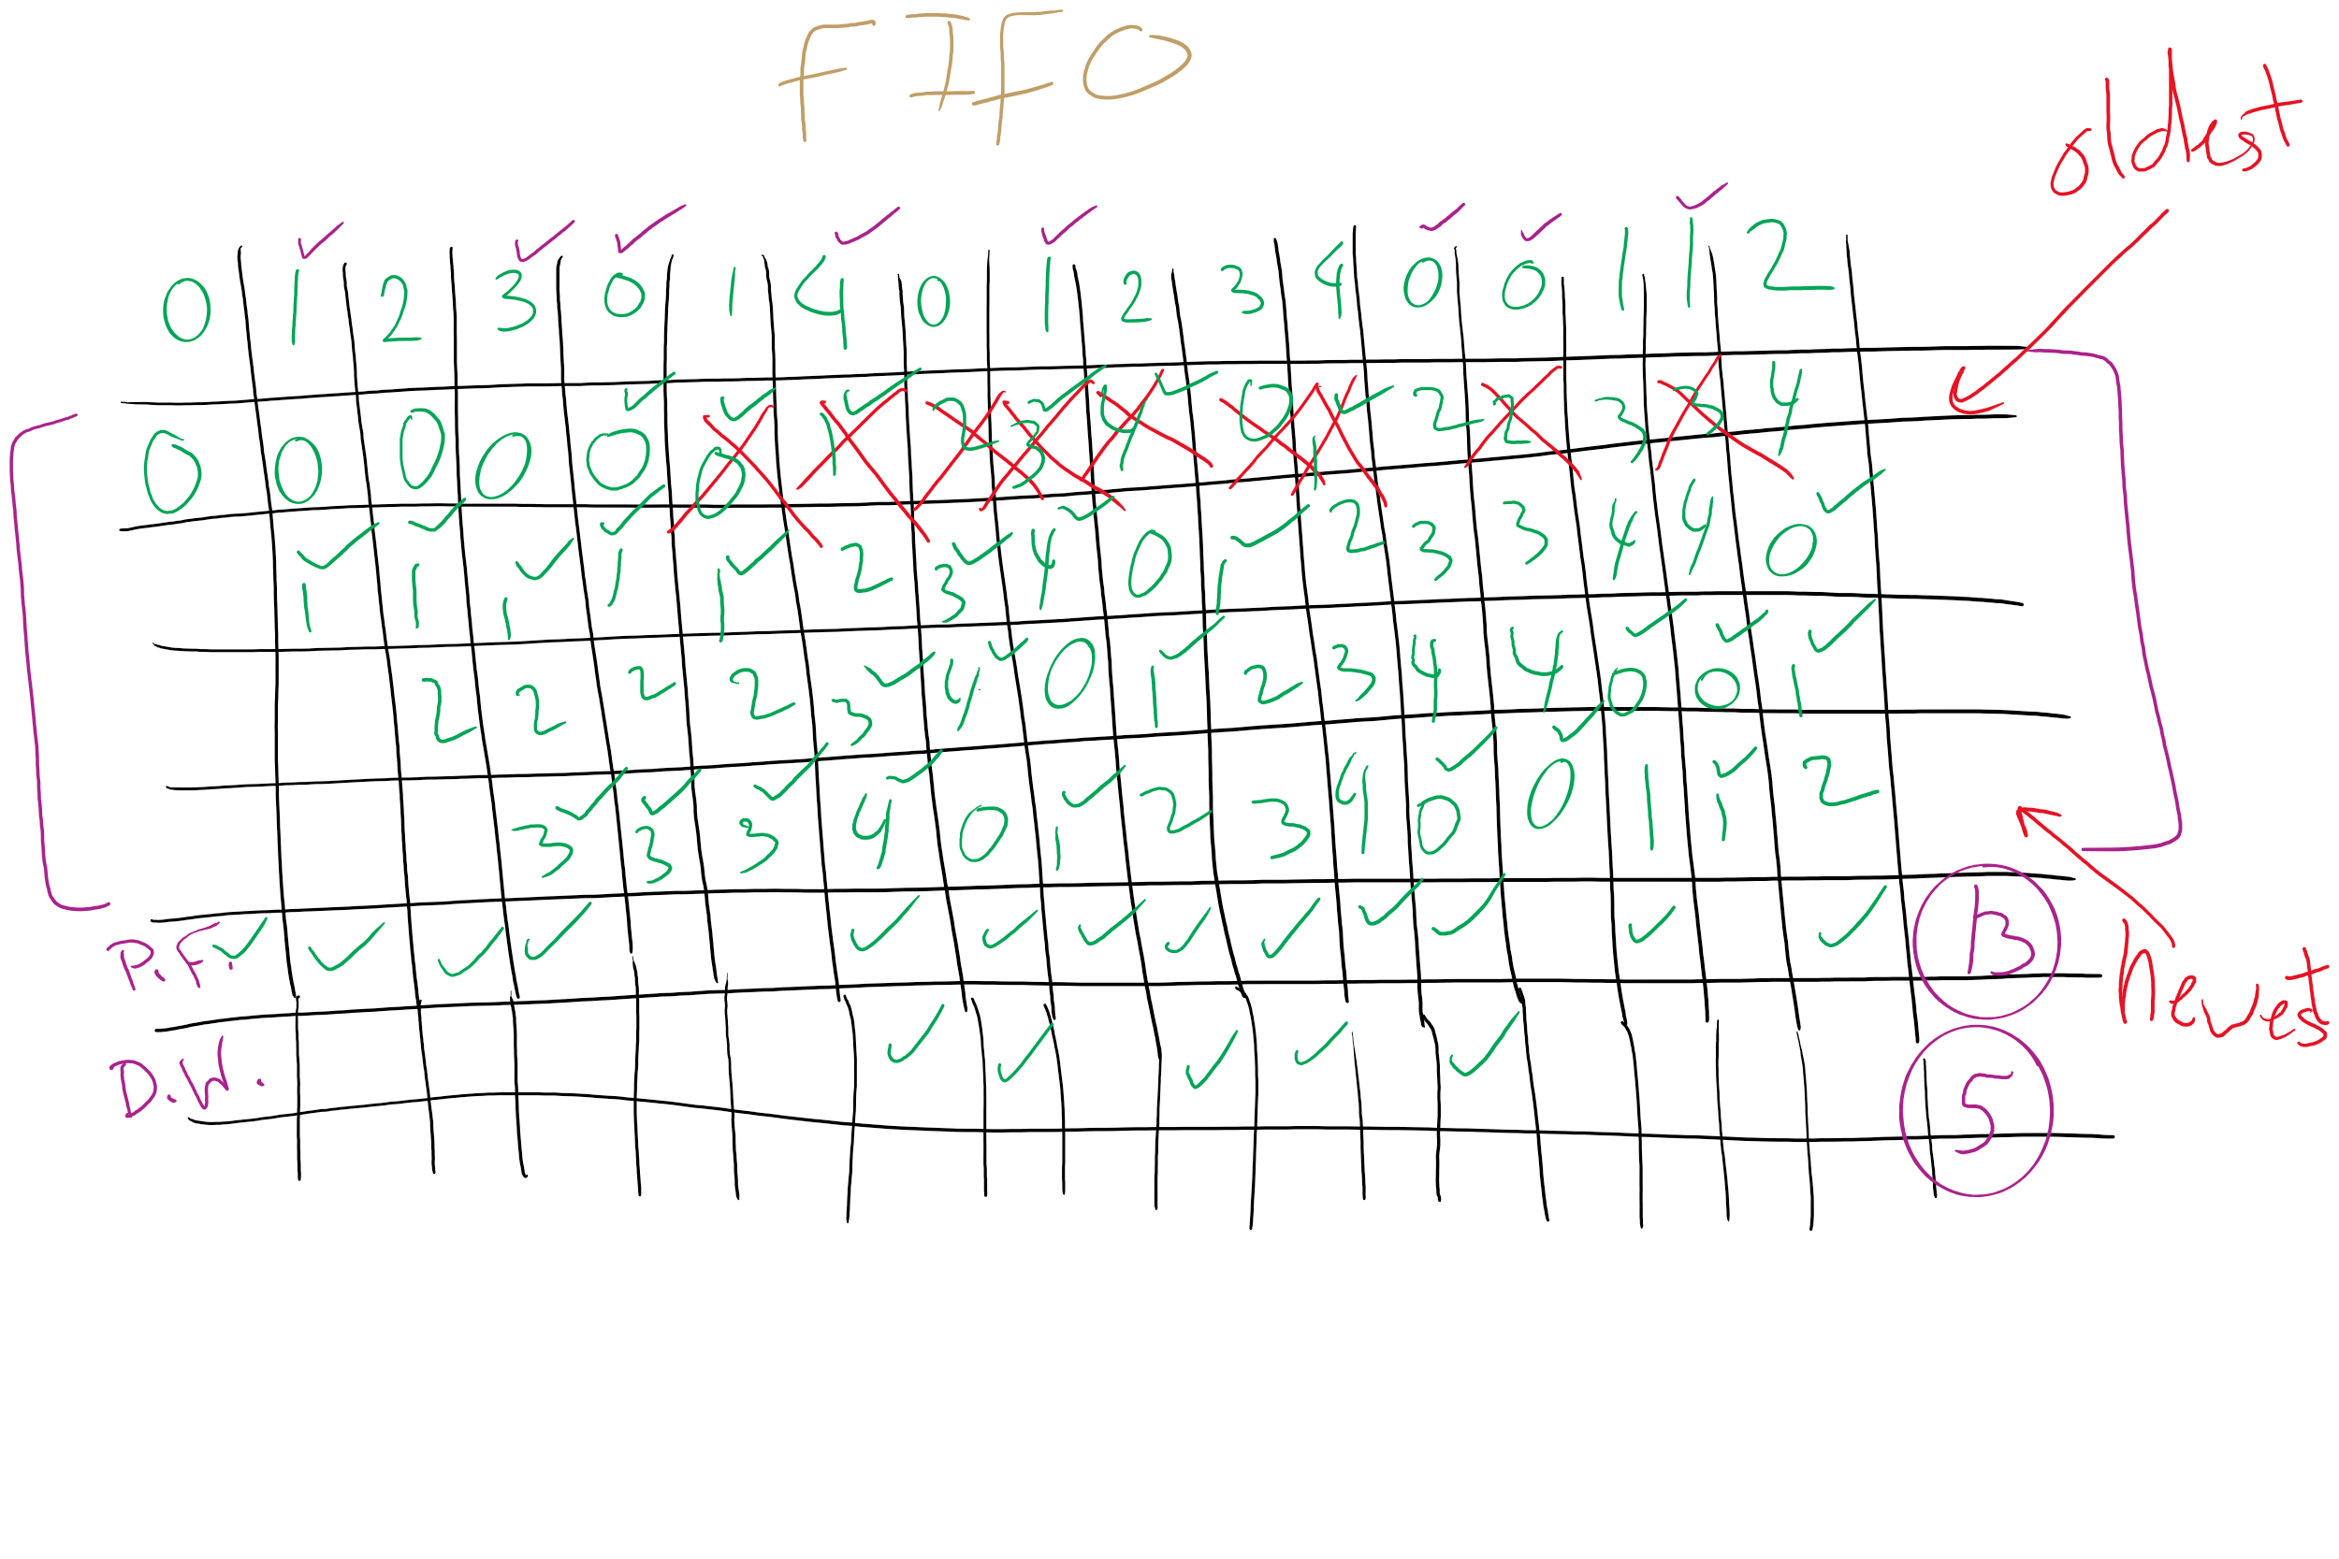
FIFO with 4 frames

Slide 7
Belady’s anomaly
Reduce the number of page faults by supplying more memory
Use previous reference string and FIFO algorithm
Add another page to physical memory (total 4 pages)
More page faults (10 vs. 9), not fewer!
This is called Belady’s anomaly
Adding more pages shouldn’t result in worse performance!
Motivated the study of paging algorithms

Slide 8
CLOCK Simulation

Slide 9
Modeling more replacement algorithms
Paging system characterized by:
Reference string of executing process
Page replacement algorithm
Number of page frames available in physical memory (m)
Model this by keeping track of all n pages referenced in array M
Top part of M has m pages in memory
Bottom part of M has n-m pages stored on disk
Page replacement occurs when page moves from top to bottom
Top and bottom parts may be rearranged without causing movement between memory and disk

Slide 10
Example: LRU
Model LRU replacement with
8 unique references in the reference string
4 pages of physical memory
Array state over time shown below
LRU treats list of pages like a stack
 | 0 | 2 | 1 | 3 | 5 | 4 | 6 | 3 | 7 | 4 | 7 | 3 | 3 | 5 | 5 | 3 | 1 | 1 | 1 | 7 | 1 | 3 | 4 | 1
 | 0 | 2 | 1 | 3 | 5 | 4 | 6 | 3 | 7 | 4 | 7 | 3 | 3 | 5 | 5 | 3 | 1 | 1 | 1 | 7 | 1 | 3 | 4 | 1
 |  | 0 | 2 | 1 | 3 | 5 | 4 | 6 | 3 | 7 | 4 | 7 | 7 | 3 | 3 | 5 | 3 | 3 | 3 | 1 | 7 | 1 | 3 | 4
 |  |  | 0 | 2 | 1 | 3 | 5 | 4 | 6 | 3 | 3 | 4 | 4 | 7 | 7 | 7 | 5 | 5 | 5 | 3 | 3 | 7 | 1 | 3
 |  |  |  | 0 | 2 | 1 | 3 | 5 | 4 | 6 | 6 | 6 | 6 | 4 | 4 | 4 | 7 | 7 | 7 | 5 | 5 | 5 | 7 | 7
 |  |  |  |  | 0 | 2 | 1 | 1 | 5 | 5 | 5 | 5 | 5 | 6 | 6 | 6 | 4 | 4 | 4 | 4 | 4 | 4 | 5 | 5
 |  |  |  |  |  | 0 | 2 | 2 | 1 | 1 | 1 | 1 | 1 | 1 | 1 | 1 | 6 | 6 | 6 | 6 | 6 | 6 | 6 | 6
 |  |  |  |  |  |  | 0 | 0 | 2 | 2 | 2 | 2 | 2 | 2 | 2 | 2 | 2 | 2 | 2 | 2 | 2 | 2 | 2 | 2
 |  |  |  |  |  |  |  |  | 0 | 0 | 0 | 0 | 0 | 0 | 0 | 0 | 0 | 0 | 0 | 0 | 0 | 0 | 0 | 0

Slide 11
Stack algorithms
LRU is an example of a stack algorithm
For stack algorithms
Any page in memory with m physical pages is also in memory with m+1 physical pages
Increasing memory size is guaranteed to reduce (or at least not increase) the number of page faults
Stack algorithms do not suffer from Belady’s anomaly
Distance of a reference == position of the page in the stack before the reference was made
Distance is ∞ if no reference had been made before
Distance depends on reference string and paging algorithm: might be different for LRU and optimal (both stack algorithms)

Slide 12
Predicting page fault rates using distance
Distance can be used to predict page fault rates
Make a single pass over the reference string to generate the distance string on-the-fly
Keep an array of counts
Entry j counts the number of times distance j occurs in the distance string
The number of page faults for a memory of size m is the sum of the counts for j>m
This can be done in a single pass!
Makes for fast simulations of page replacement algorithms
This is why virtual memory theorists like stack algorithms!

Slide 13
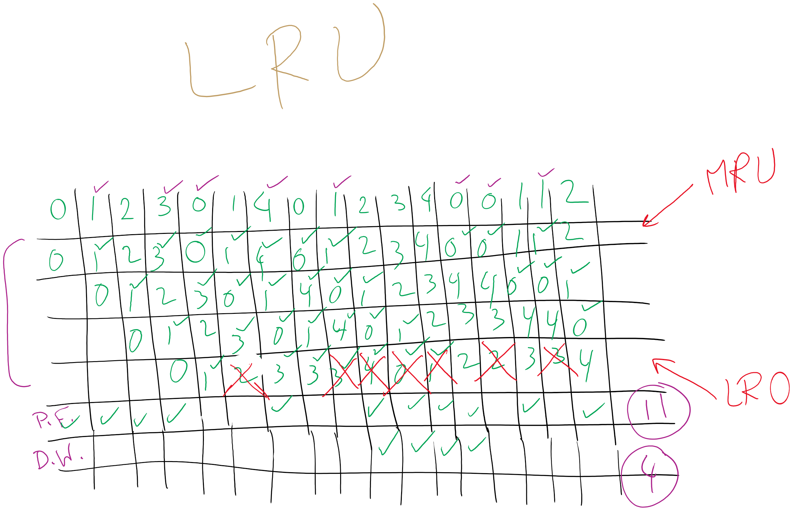
LRU

Slide 14
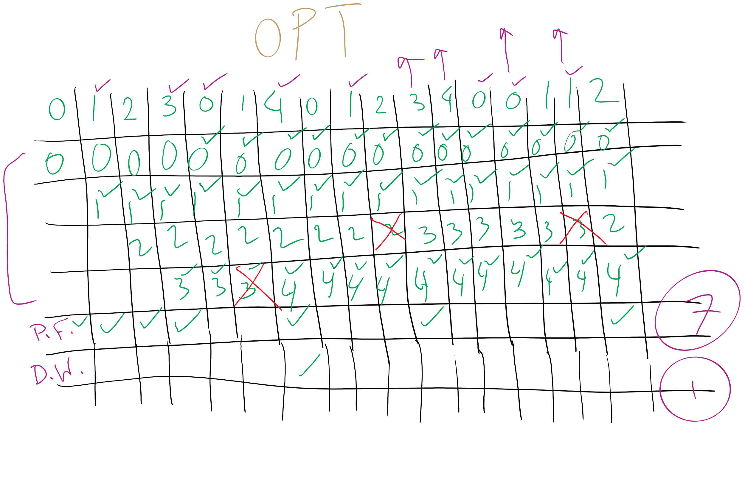
OPT

Slide 15
Local vs. global allocation policies
What is the pool of pages eligible to be replaced?
Pages belonging to the process needing a new page
All pages in the system
Local allocation: replace a page from this process
May be more “fair”: penalize processes that replace many pages
Can lead to poor performance: some processes need more pages than others
Global allocation: replace a page from any process
Last access time
Page
A0
14
A1
12
Local allocation
A2
8
A3
A4
5
A4
B0
10
B1
9
Global allocation
B2
A4
3
C0
16
C1
12
C2
8
C3
5
C4
4

Slide 16
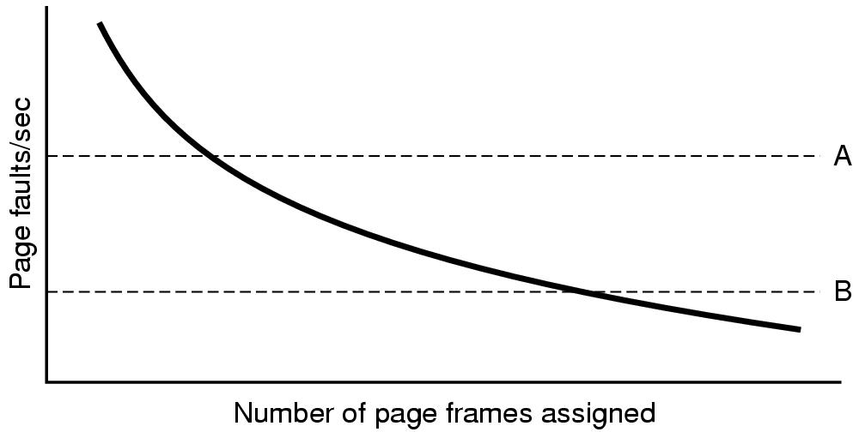
Page fault rate vs. allocated frames
Local allocation may be more “fair”
Don’t penalize other processes for high page fault rate
Global allocation is better for overall system performance
Take page frames from processes that don’t need them as much
Reduce the overall page fault rate (even though rate for a single process may go up)

Slide 17
Control overall page fault rate
Despite good designs, system may still thrash
Most (or all) processes have high page fault rate
Some processes need more memory, …
but no processes need less memory (and could give some up)
Problem: no way to reduce page fault rate
Solution : Reduce number of processes competing for memory
Swap one or more to disk, divide up pages they held
Reconsider degree of multiprogramming

Slide 18

Backing up an instruction
Problem: page fault happens in the middle of instruction execution
Some changes may have already happened
Others may be waiting for VM to be fixed
Solution: undo all of the changes made by the instruction
Restart instruction from the beginning
This is easier on some architectures than others
Example: LW R1, 12(R2)
Page fault in fetching instruction: nothing to undo
Page fault in getting value at 12(R2): restart instruction

Slide 19
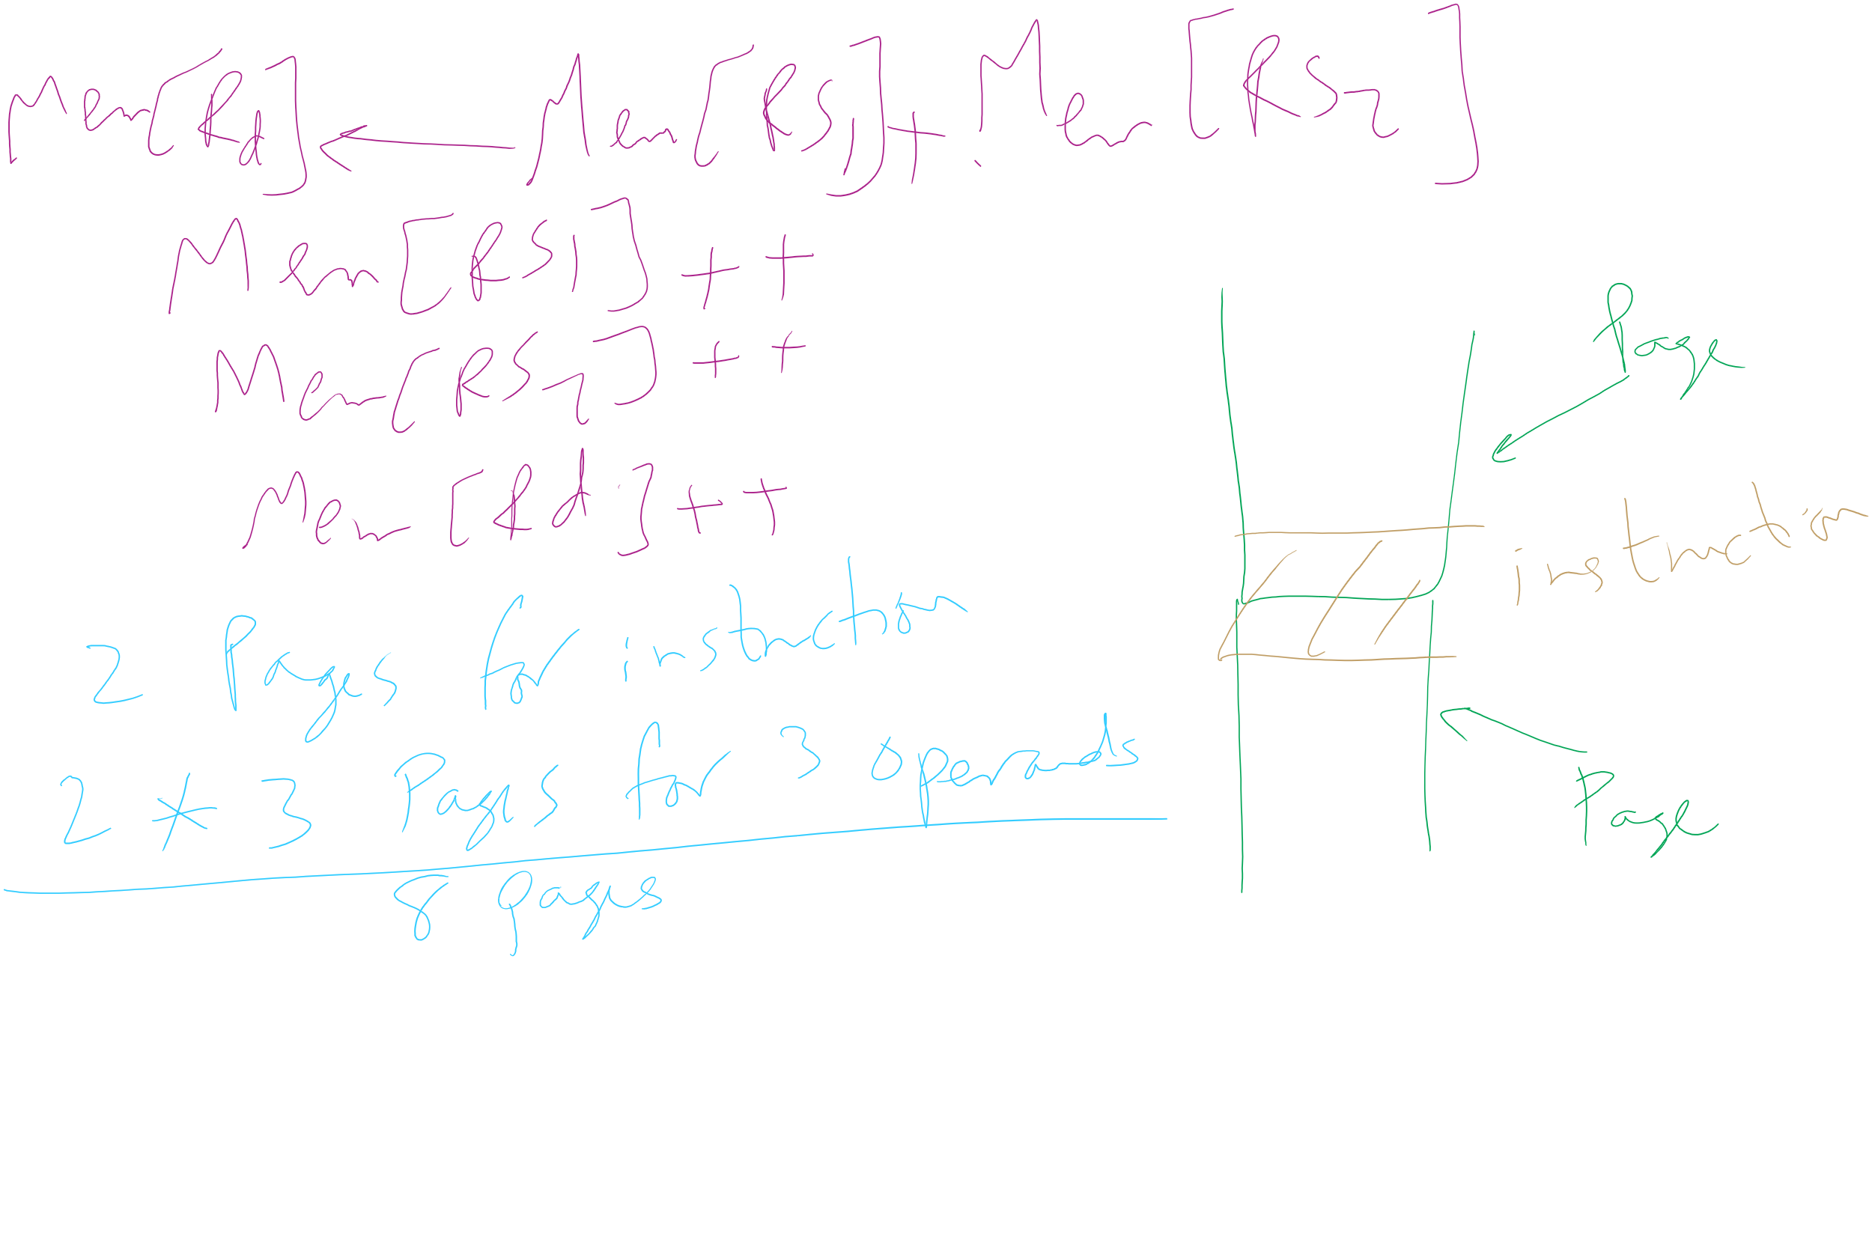
Minimum memory allocation to a process
Example: ADD (Rd)+,(Rs1)+,(Rs2)+
Page fault in writing to (Rd): may have to undo an awful lot…

Slide 20
Separating policy and mechanism
Mechanism for page replacement has to be in kernel
Modifying page tables
Reading and writing page table entries
Policy for deciding which pages to replace could be in user space
More flexibility
3. Request page
User process
External pager
4. Page arrives
User space
2. Page needed
5. Here is page!
Kernel space
Fault handler
MMU handler
1. Page fault
6. Map in page

Slide 21
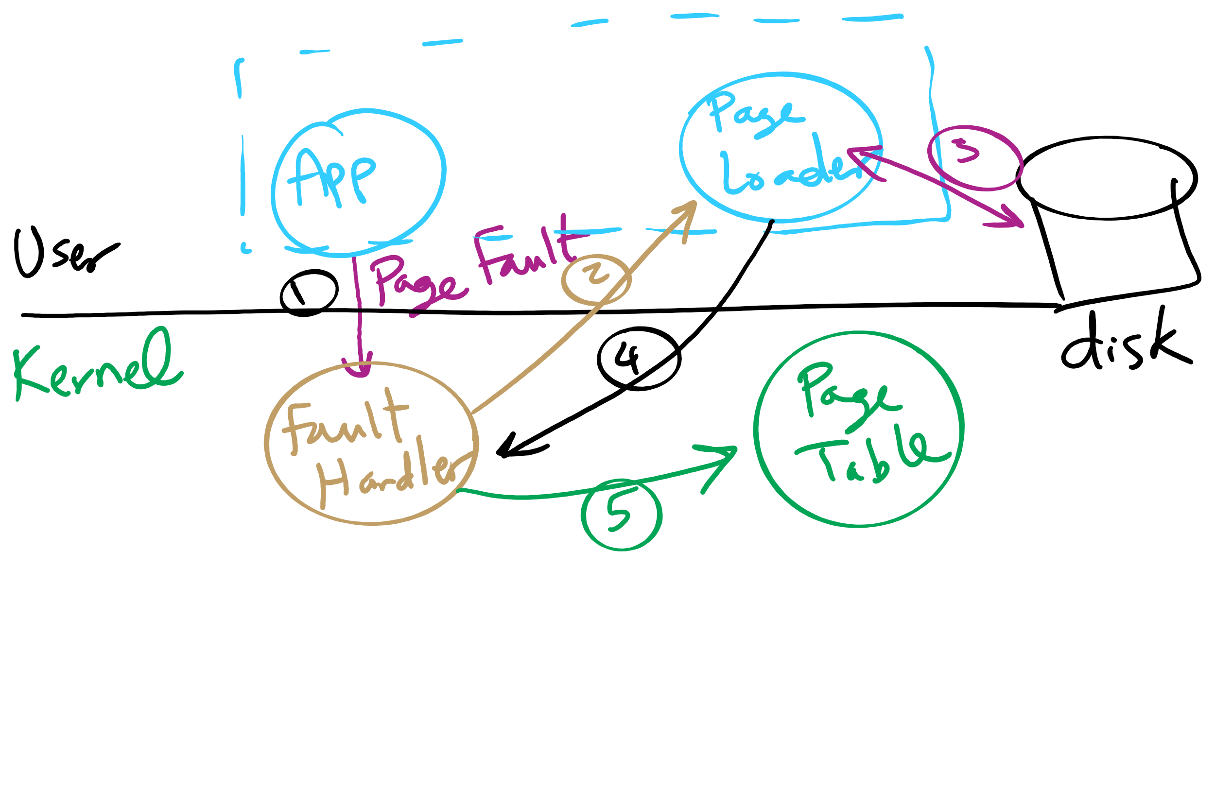
Separating Policy and Mechanism for Page Replacement

Slide 22
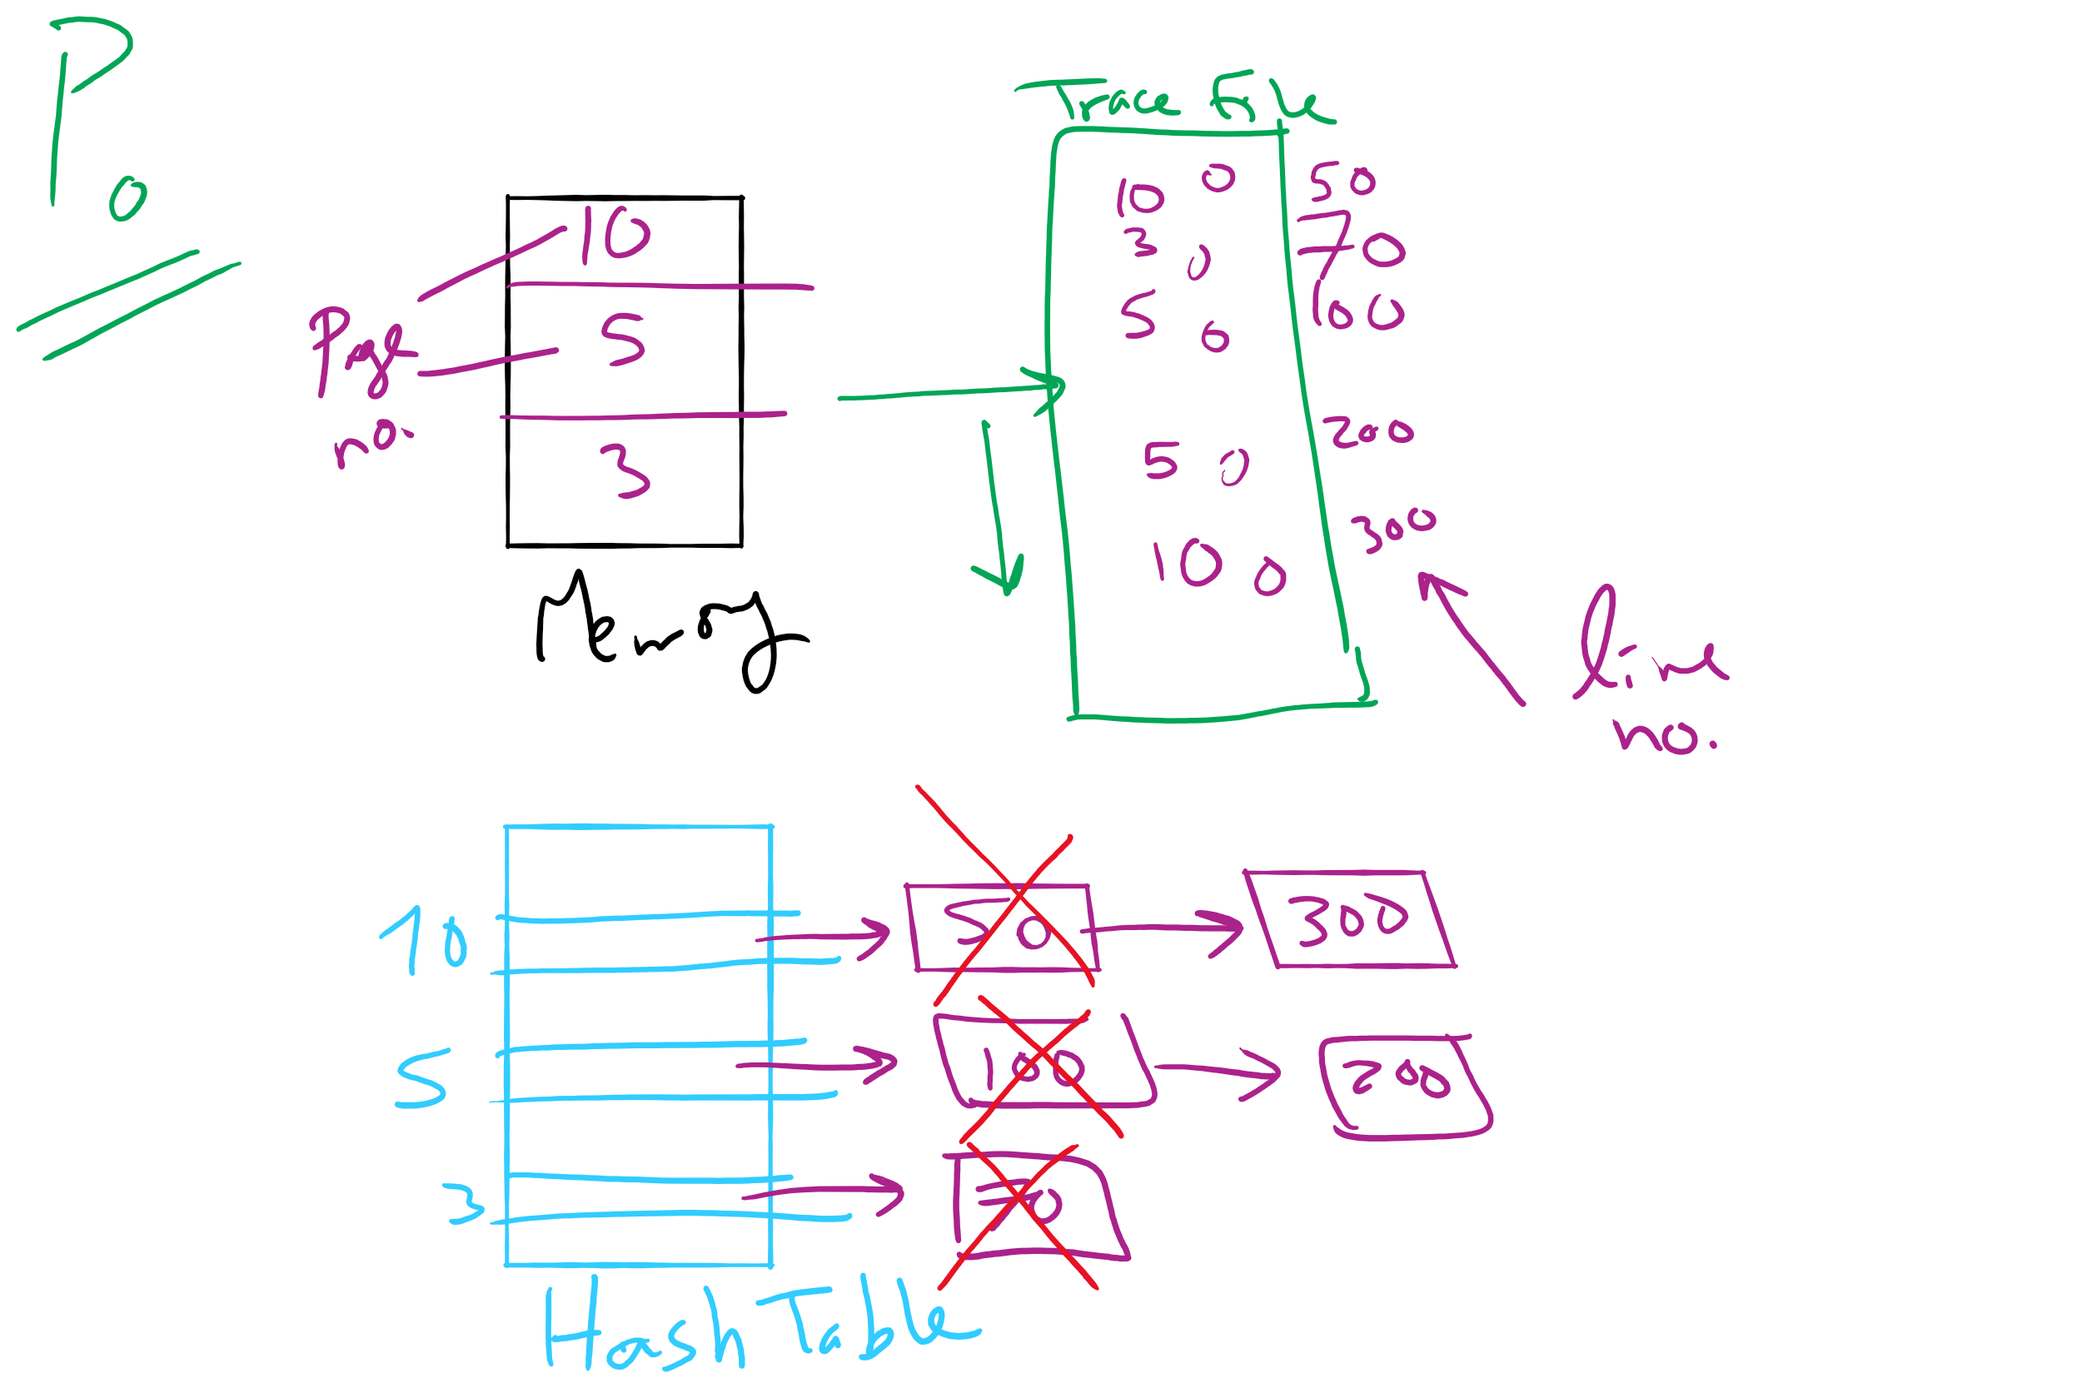
Project 3: OPT Simulation

Slide 23
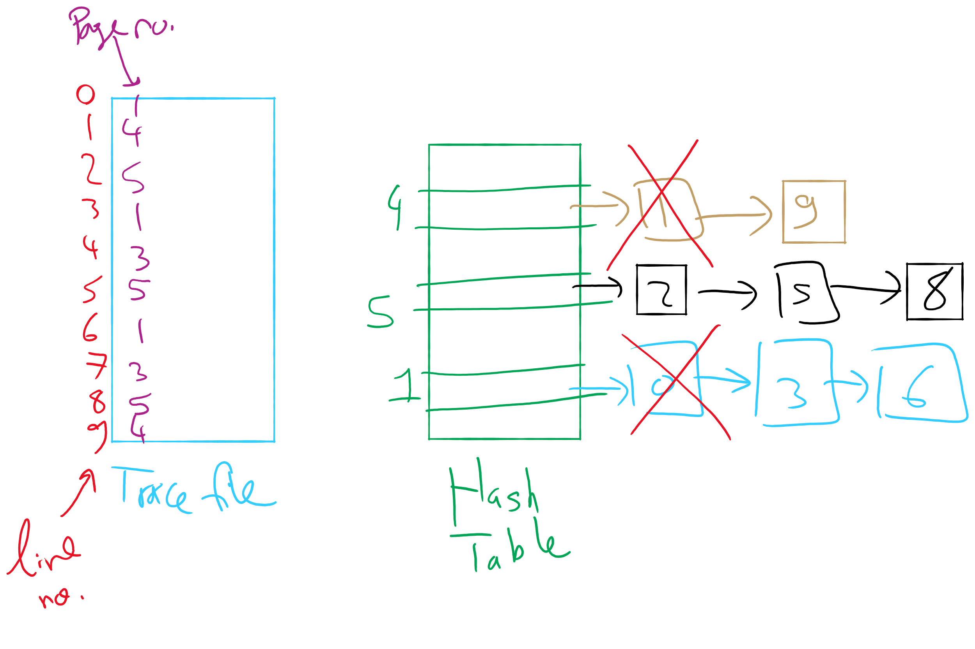
OPT Implementation Example

Slide 24

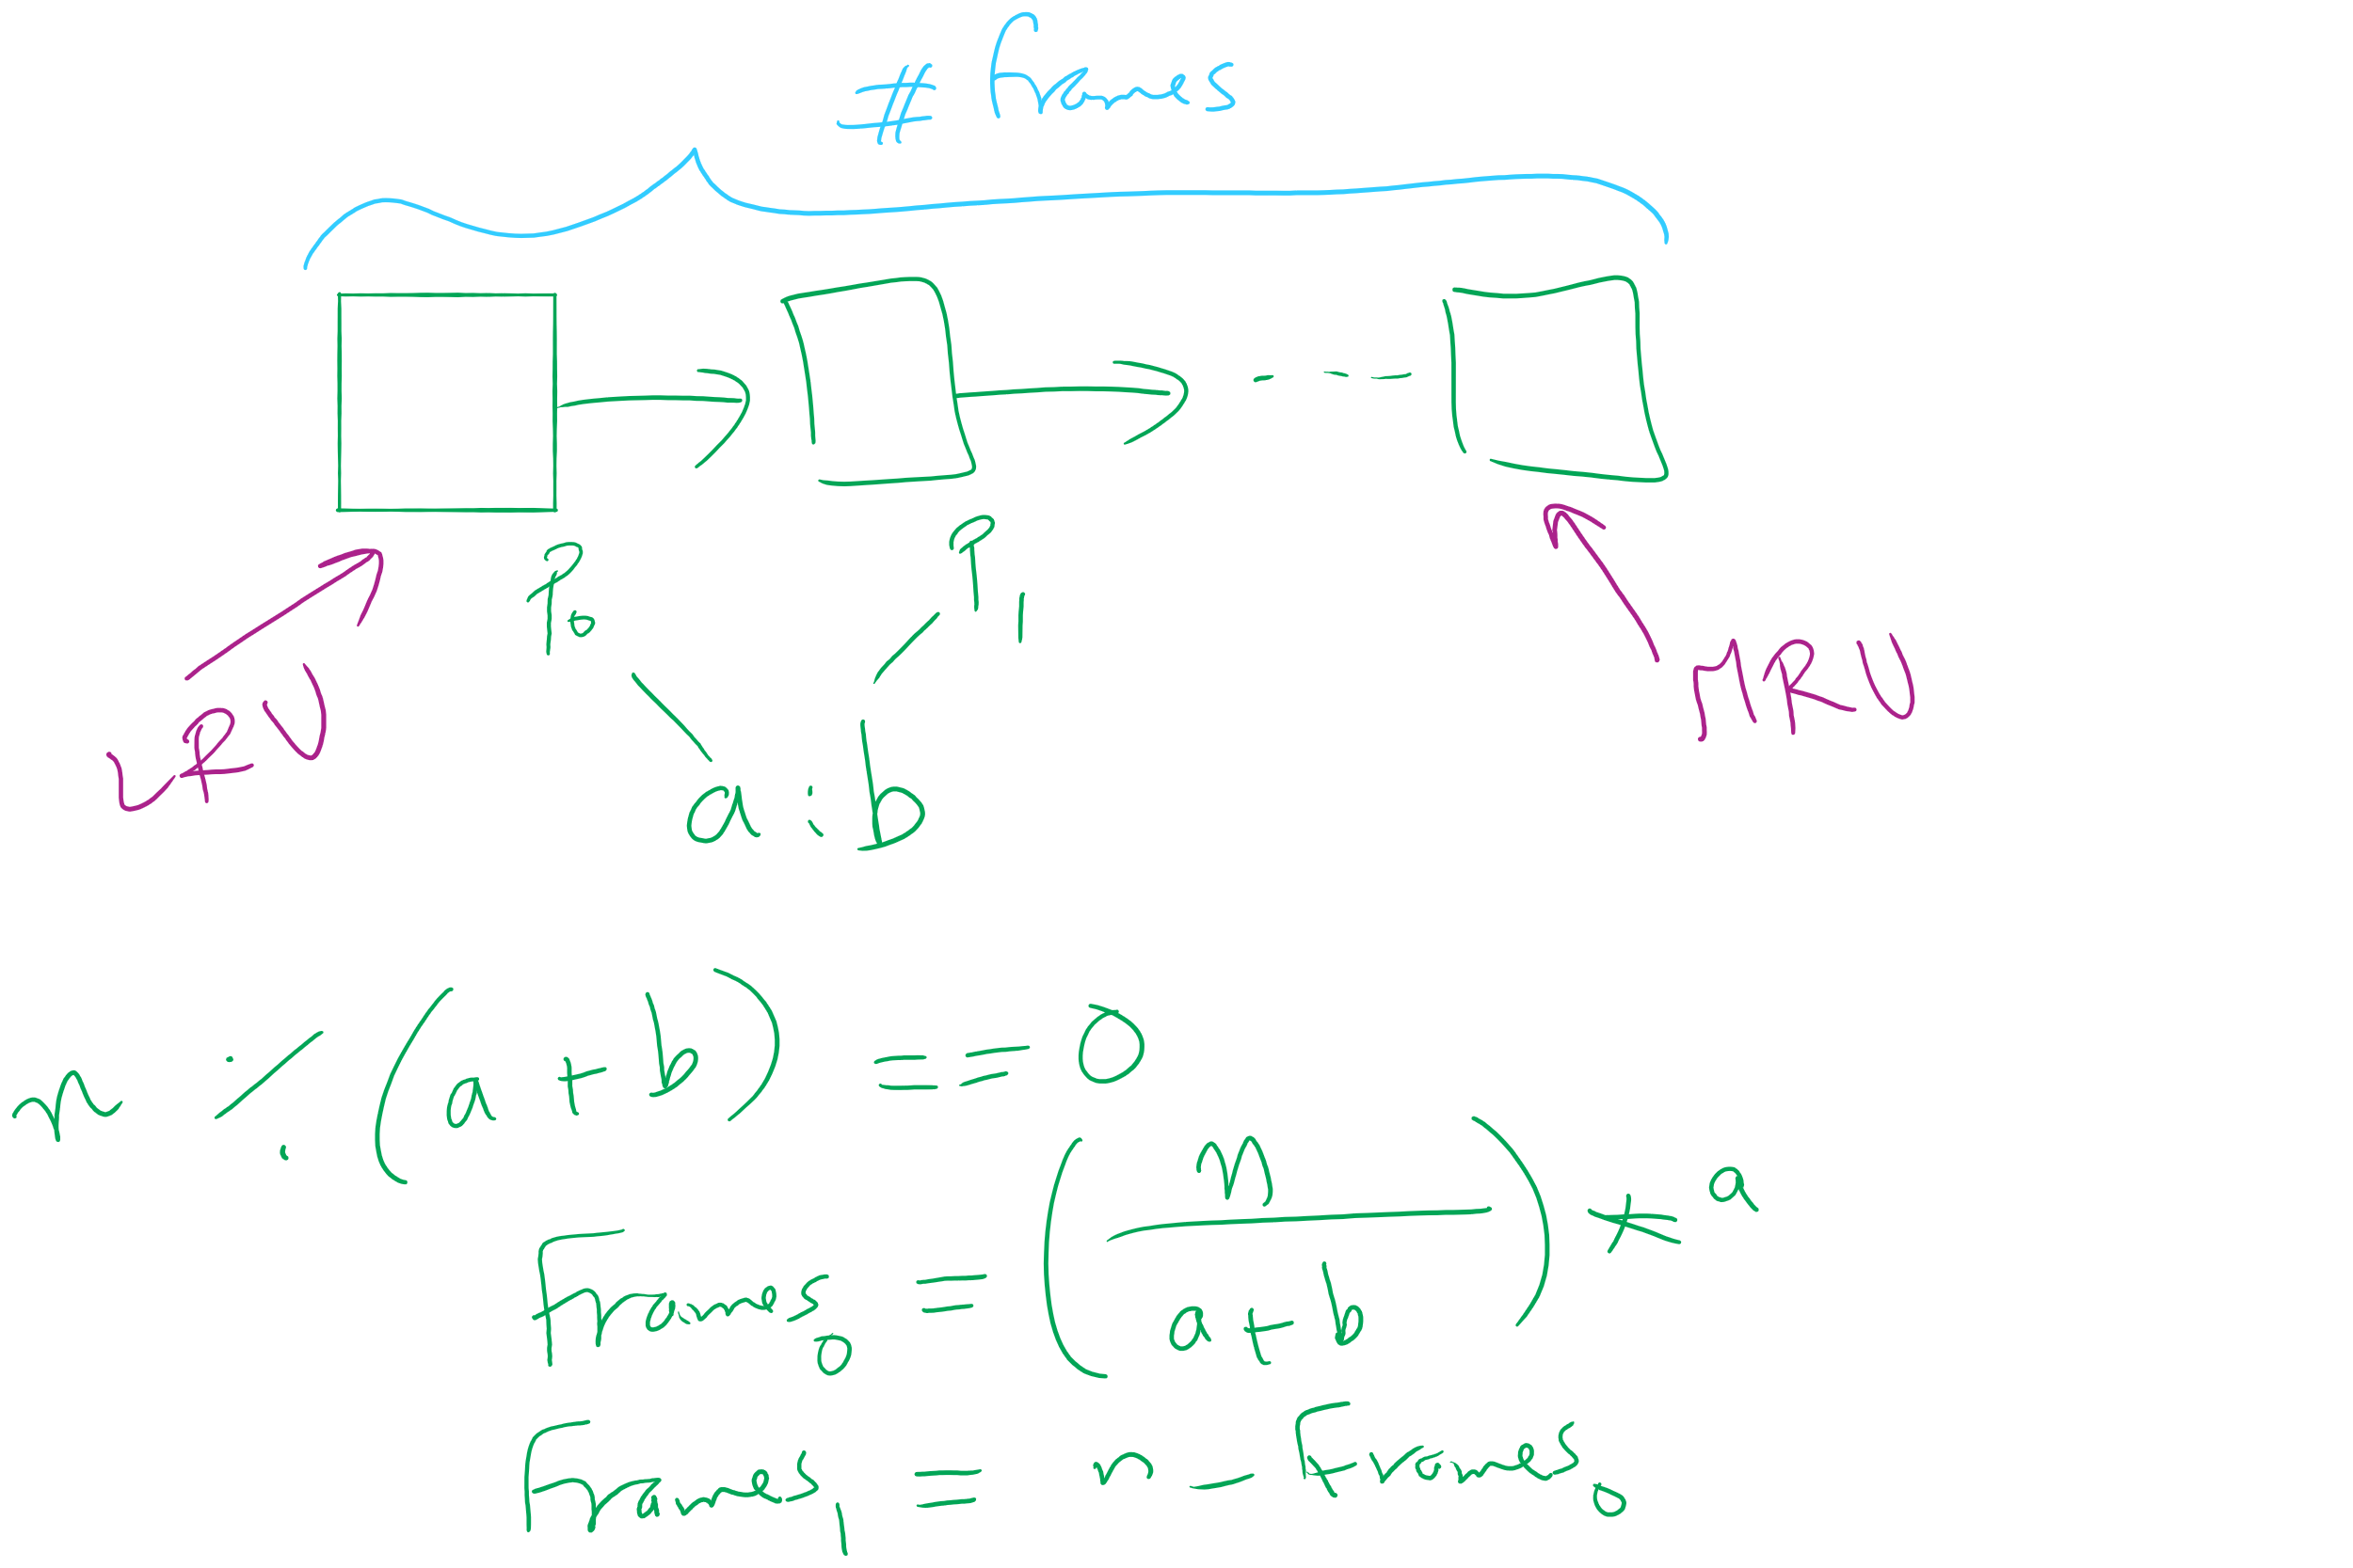
Project 3: LRU and miscellaneous hints

Slide 25
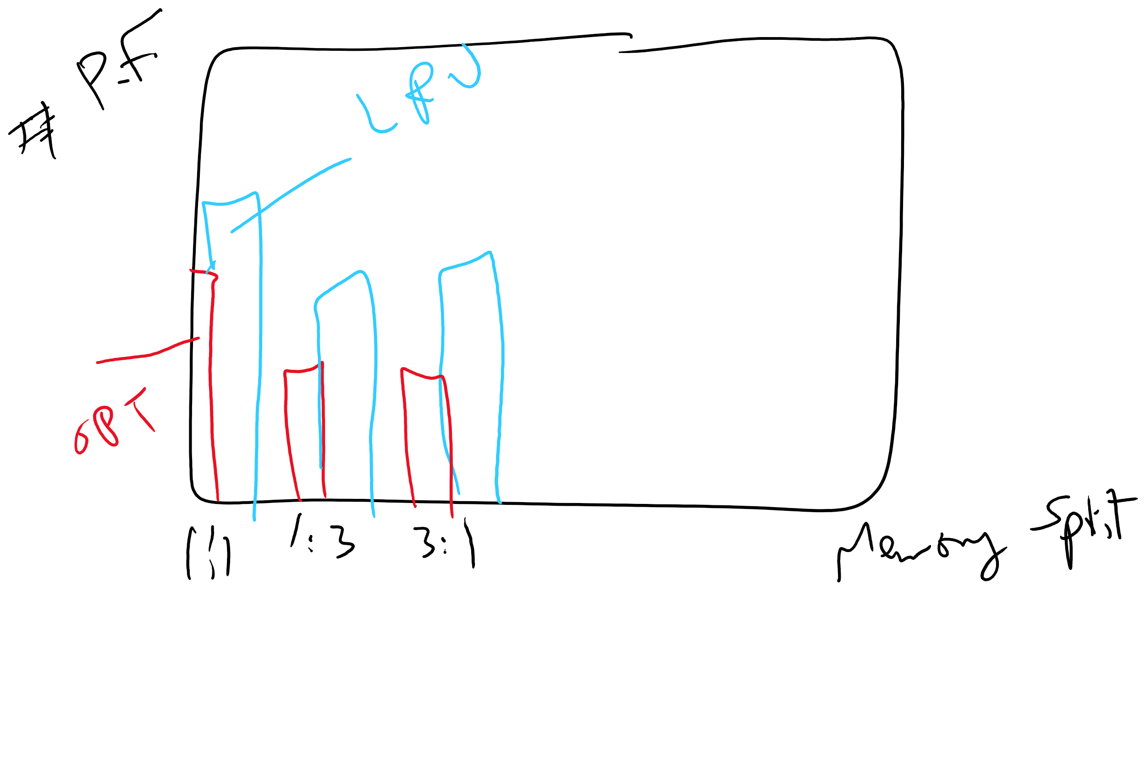
Project 3: Writeup hints

Slide 26
Problem of the Day
How to keep track of larger page tables that can store more pages
How big can a page table be?
64-bit machine
4 KB page size
How many pages?
How many PTE?
How big is a PTE?
How big is the page table of one process?

Slide 27
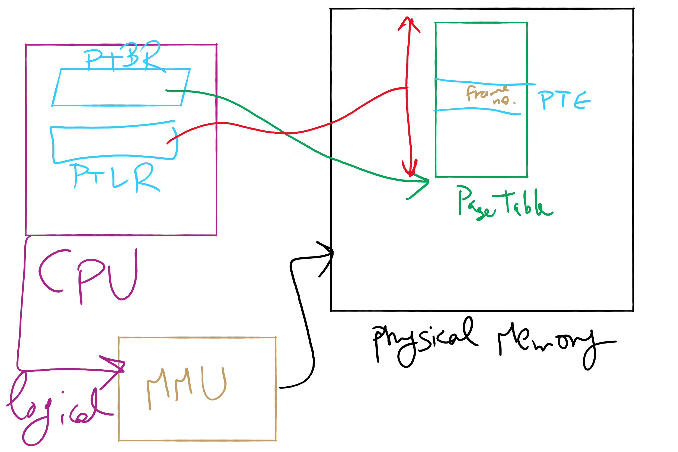
Address Translation Structures

Slide 28
Memory & paging structures
Physical memory
Page frame number
Page 0
6
Page 1
3
0
Page 1 (P1)
Page 2
4
1
Page 3
9
2
Page 4 (P0)
Page 4
2
3
Page 1 (P0)
Free
pages
4
Page 2 (P0)
Logical memory (P0)
Page table (P0)
5
6
Page 0 (P0)
Page 0
8
7
Page 1
0
8
Page 0 (P1)
9
Page 3 (P0)
Logical memory (P1)
Page table (P1)

Slide 29
Mapping logical => physical address
Split address from CPU into two pieces
Page number (p)
Page offset (d)
Page number
Index into page table
Page table contains base address of page in physical memory
Page offset
Added to base address to get actual physical memory address
Page size = 2^{d} bytes
Example:
• 4 KB (=4096 byte) pages
• 32 bit logical addresses
2^{d} = 4096
d = 12
32-12 = 20 bits
12 bits
p
d
32 bit logical address

Slide 30
Address translation architecture
page number
Page frame number
Page frame number
page offset
0
CPU
p
d
f
d
1
. . .
0
f-1
1
f
. . .
f+1
p-1
f+2
p
f
. . .
p+1
physical memory
page table

Slide 31
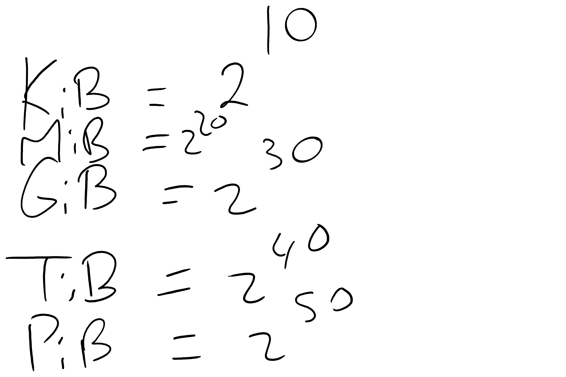
Memory Sizes

Slide 32
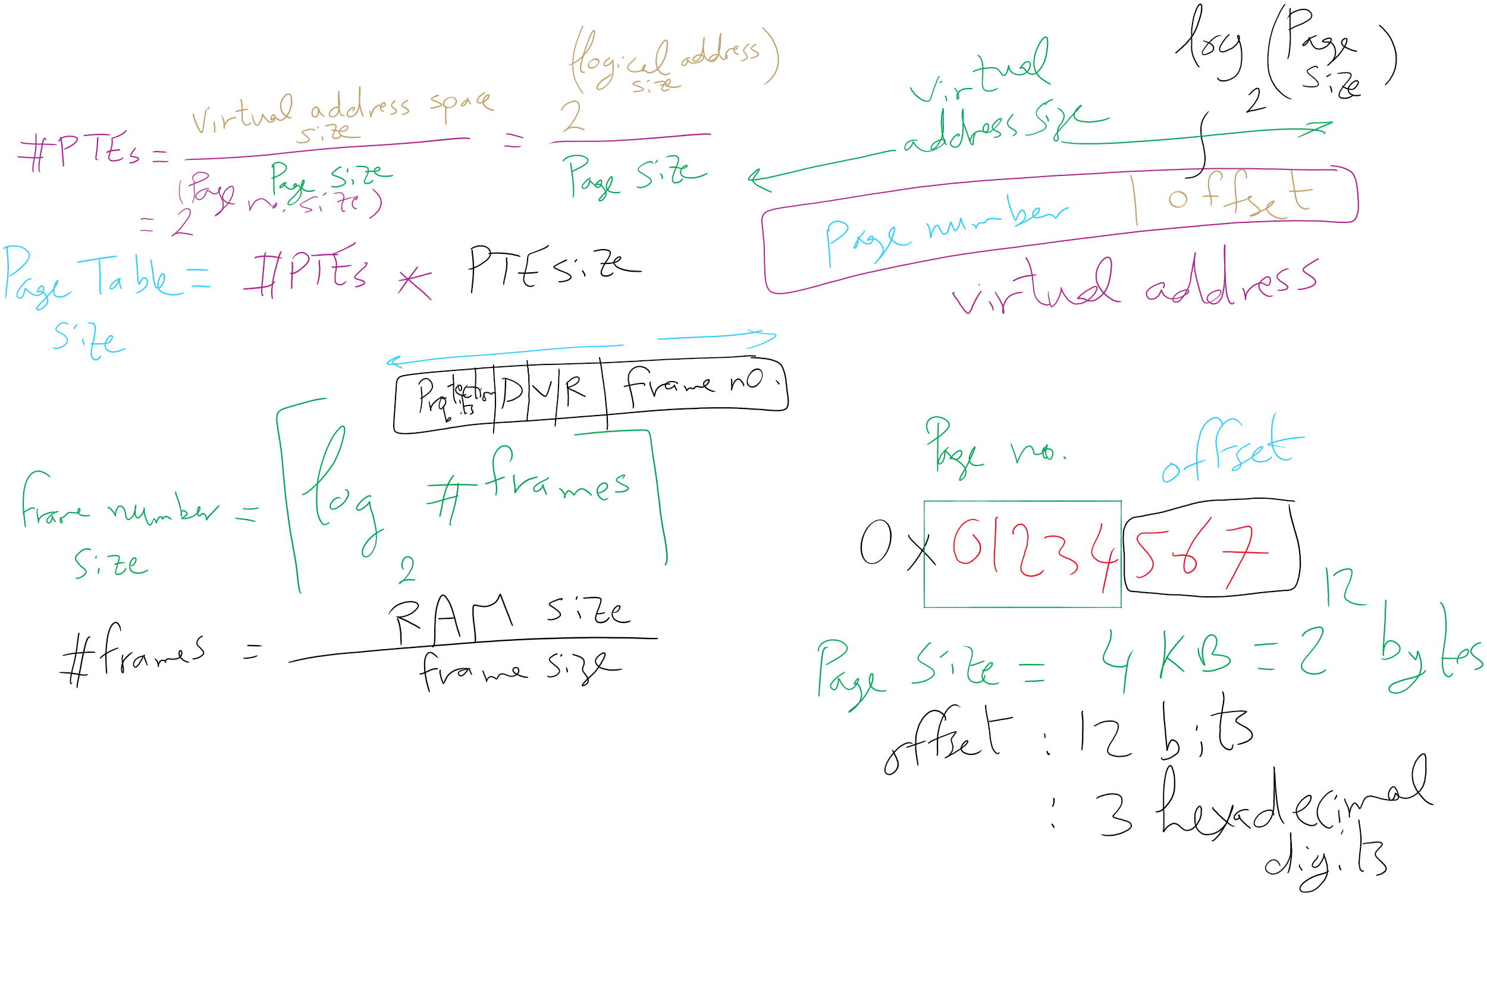
Address Translation Relations

Slide 33
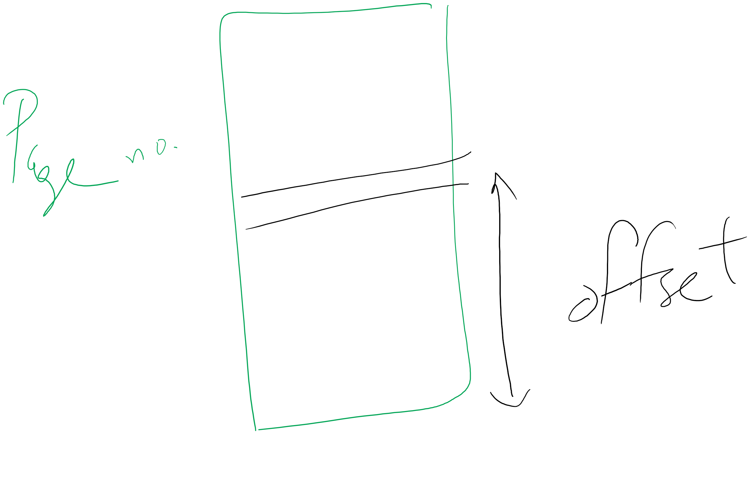
Page number vs. Offset

Slide 34
Solution 1: Two-level page tables
Problem: page tables can be too large
2³² bytes in 4KB pages need 1 million PTEs
Solution: use multi-level page tables
“Page size” in first page table is large (megabytes)
PTE marked invalid in first page table needs no 2nd level page table
1st level page table has pointers to 2nd level page tables
2nd level page table has actual physical page numbers in it
. . .
220
. . .
657
. . .
. . .
401
. . .
. . .
. . .
125
613
. . .
. . .
. . .
1st level page table
961
. . .
884
960
. . .
2nd level page tables
. . .
main memory
955

Slide 35
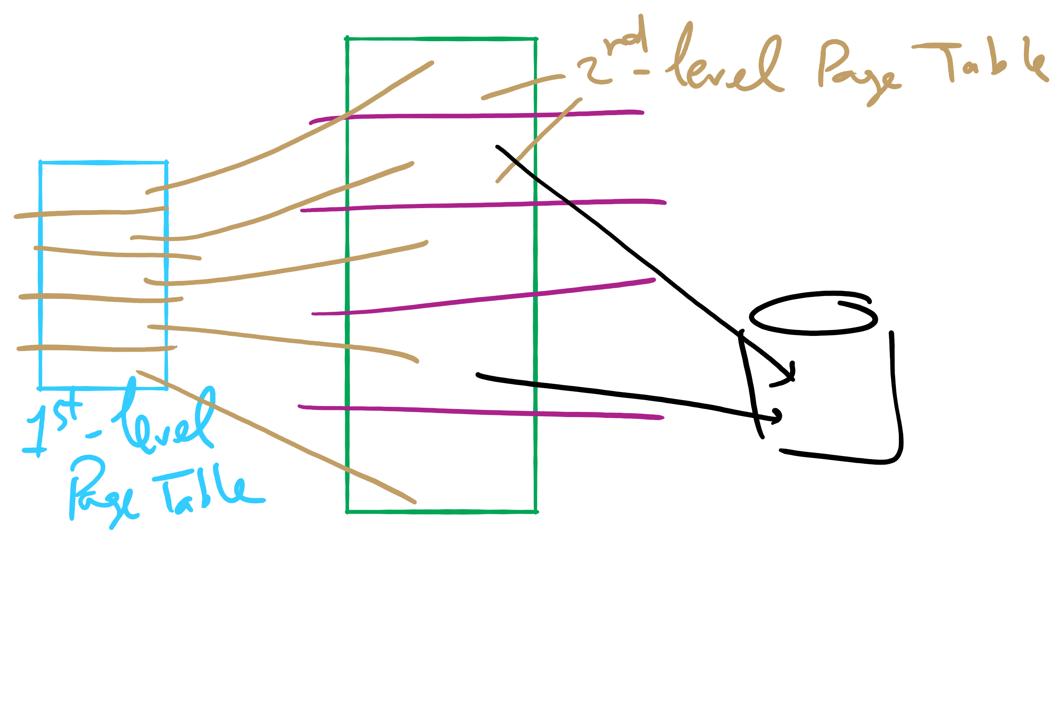
Two-level Page Table

Slide 36
More on two-level page tables
Tradeoffs between 1st and 2nd level page table sizes
Total number of bits indexing 1st and 2nd level table is constant for a given page size and logical address length
Tradeoff between number of bits indexing 1st and number indexing 2nd level tables
More bits in 1st level: fine granularity at 2nd level
Fewer bits in 1st level: maybe less wasted space?
All addresses in table are physical addresses
Protection bits kept in 2nd level table

Slide 37
Two-level paging: example
System characteristics
8 KB pages
32-bit logical address divided into 13 bit page offset, 19 bit page number
Page number divided into:
10 bit page number
9 bit page offset
Logical address looks like this:
p₁ is an index into the 1st level page table
p₂ is an index into the 2nd level page table pointed to by p₁
page number
page offset
p₁ = 10 bits
p₂ = 9 bits
offset = 13 bits

Slide 38
2-level address translation example
page number
page offset
p₁ = 10 bits
p₂ = 9 bits
offset = 13 bits
frame number
0
Page table base
physical address
1
0
19
13
. . .
1
. . .
0
1
p₁
. . .
. . .
. . .
p₂
main memory
1st level page table
. . .
2nd level page table

Slide 39
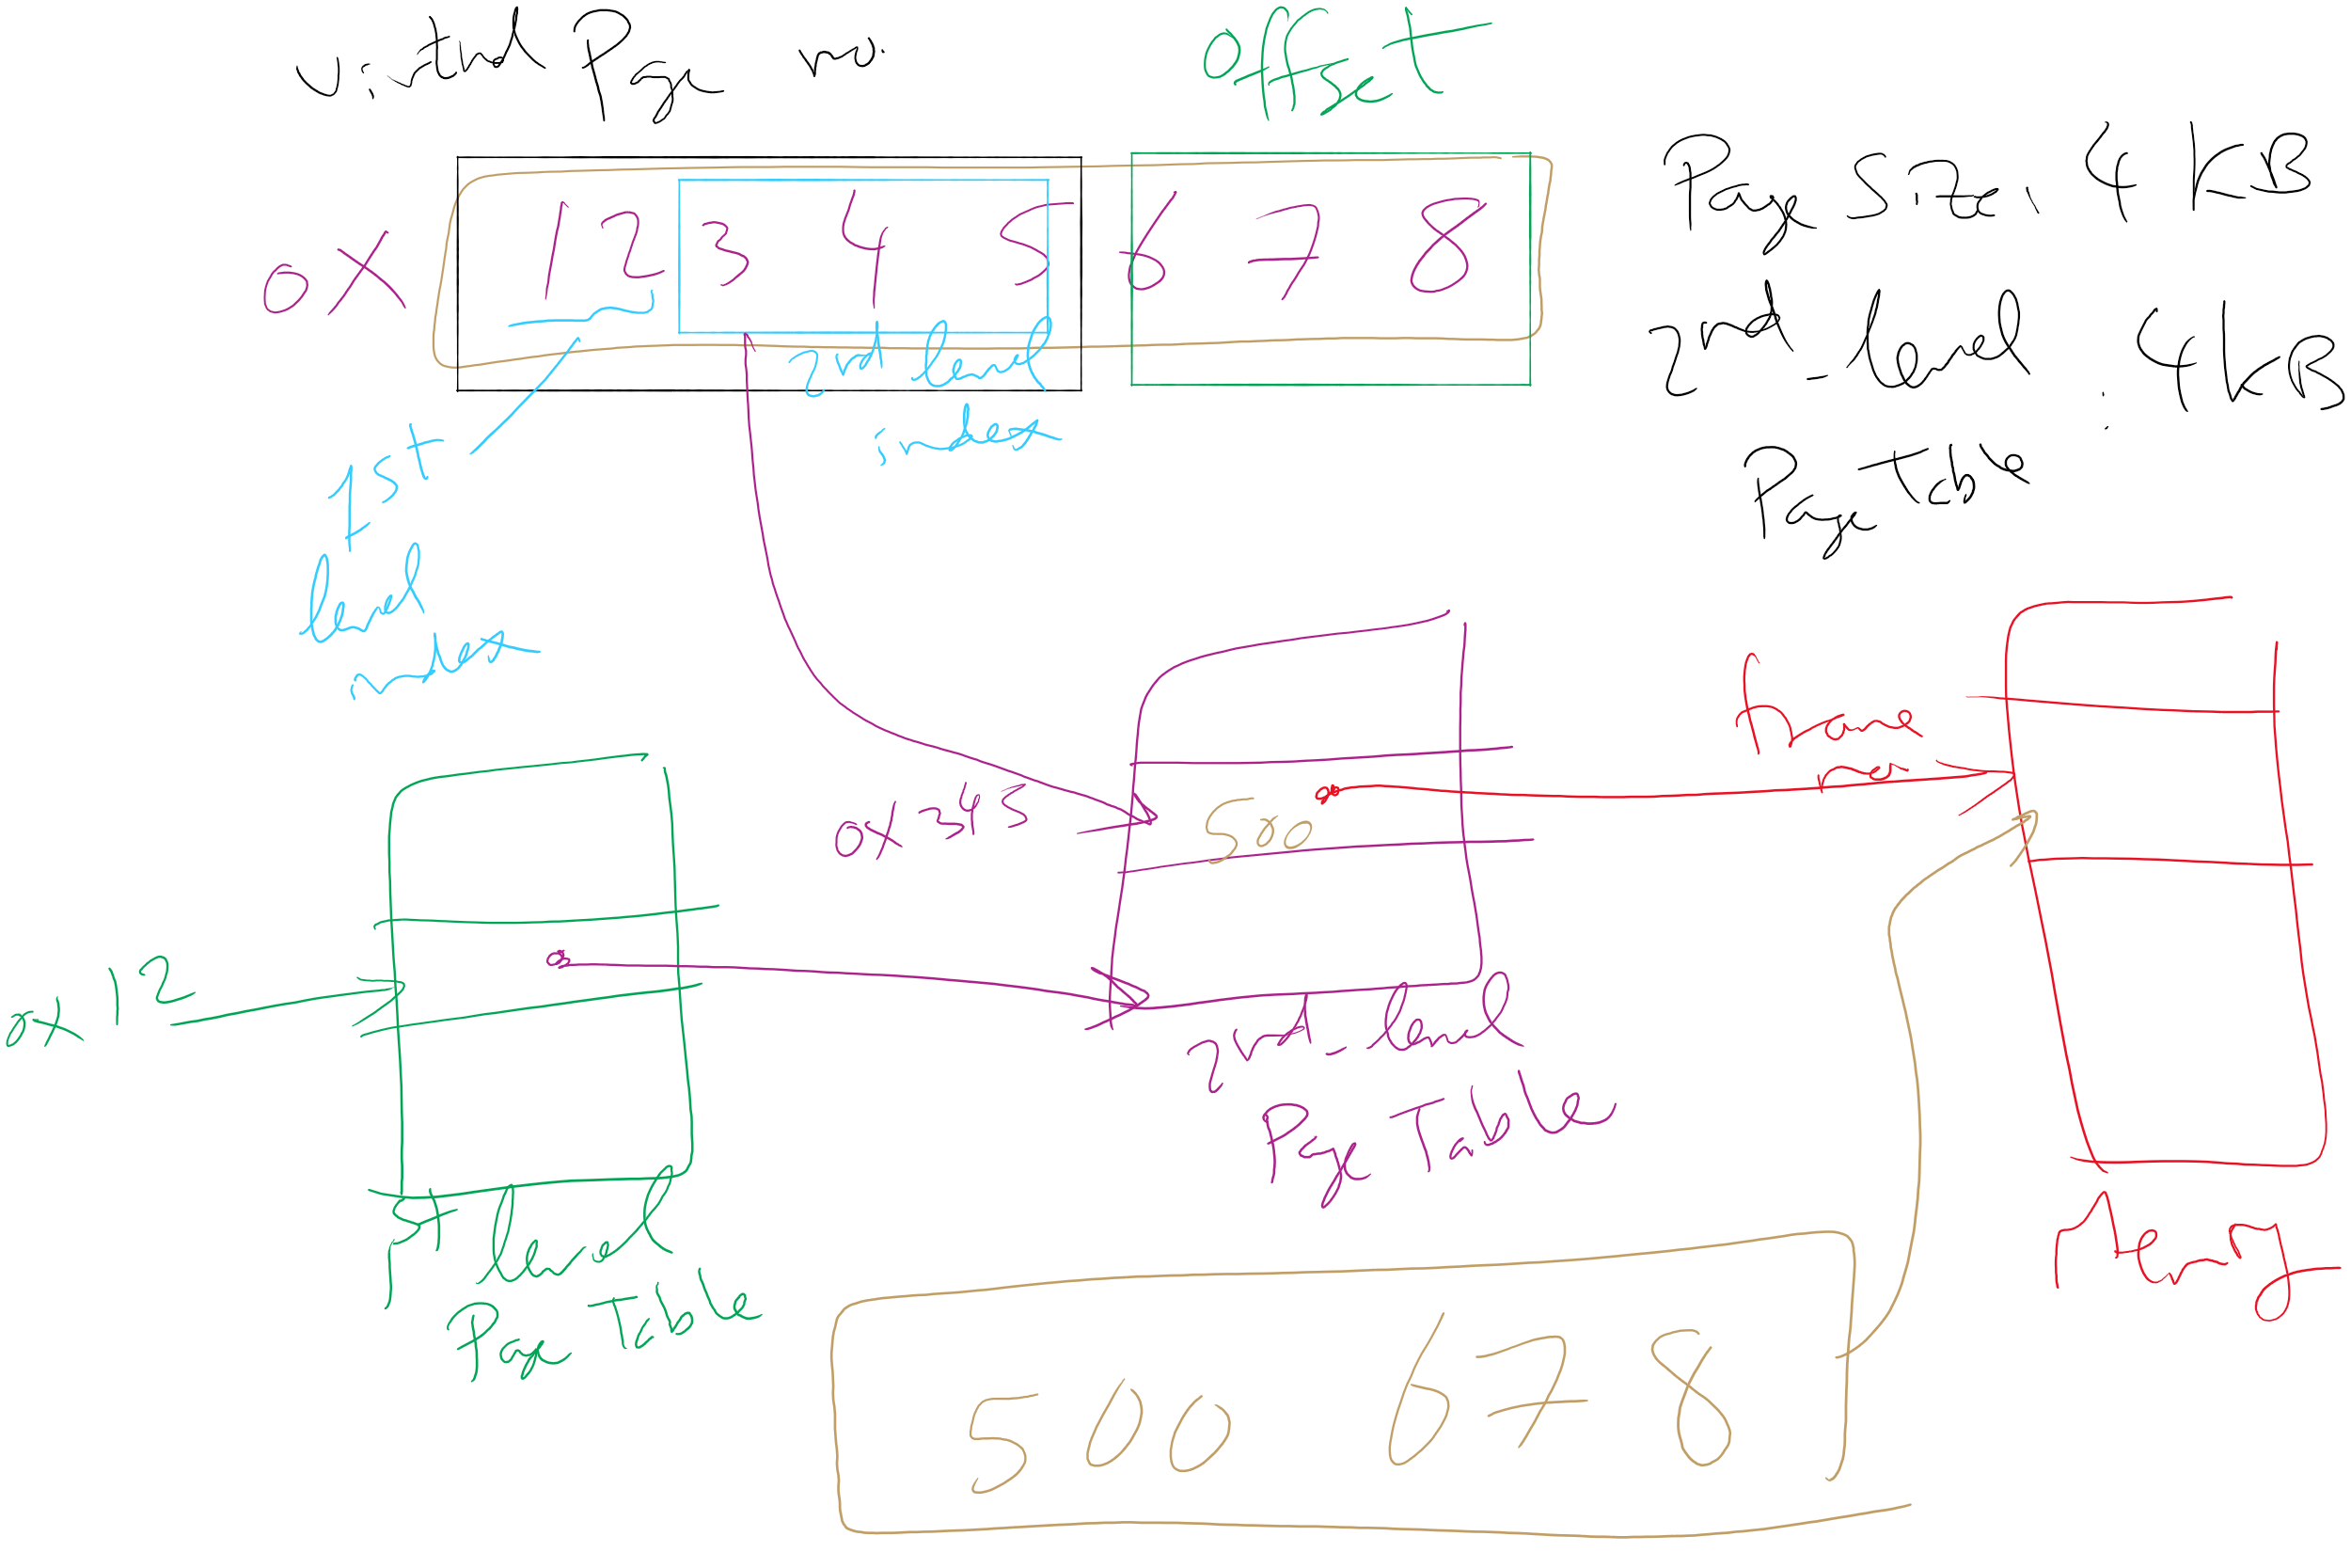
Address Translation: 2-level Page Table

Slide 40
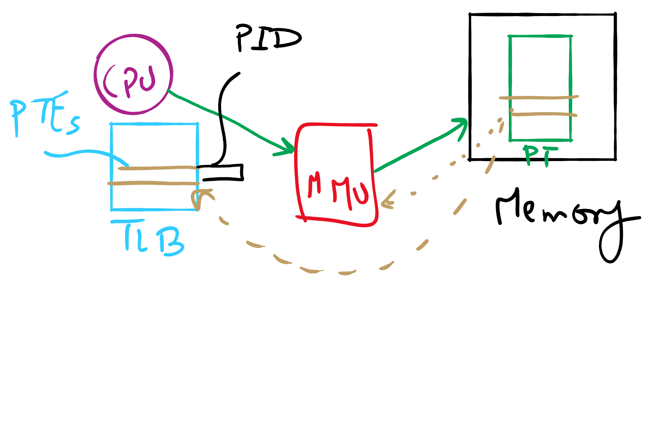
TLB

Slide 41
Translation Lookaside Buffer (TLB)
Search the TLB for the desired logical page number
Search entries in parallel
Use standard cache techniques
If desired logical page number is found, get frame number from TLB
If desired logical page number isn’t found
Get frame number from page table in memory
Replace an entry in the TLB with the logical & physical page numbers from this reference
Logical page #
Physical frame #
8
3
unused
2
1
3
0
12
12
29
6
22
11
7
4
Example TLB

Slide 42
Handling TLB misses
If PTE isn’t found in TLB, OS needs to do the lookup in the page table
Lookup can be done in hardware or software
Hardware TLB replacement
CPU hardware does page table lookup
Can be faster than software
Less flexible than software, and more complex hardware
Software TLB replacement
OS gets TLB exception
Exception handler does page table lookup & places the result into the TLB
Program continues after return from exception
Larger TLB (lower miss rate) can make this feasible

Slide 43
How long do memory accesses take?
Assume the following times:
TLB lookup time = a (often zero - overlapped in CPU)
Memory access time = m
Hit ratio (h) is percentage of time that a logical page number is found in the TLB
Larger TLB usually means higher h
TLB structure can affect h as well
Effective access time (an average) is calculated as:
EAT = (m + a)h + (m + m + a)(1-h)
EAT =a + (2-h)m
Interpretation
Reference always requires TLB lookup, 1 memory access
TLB misses also require an additional memory reference

Slide 44
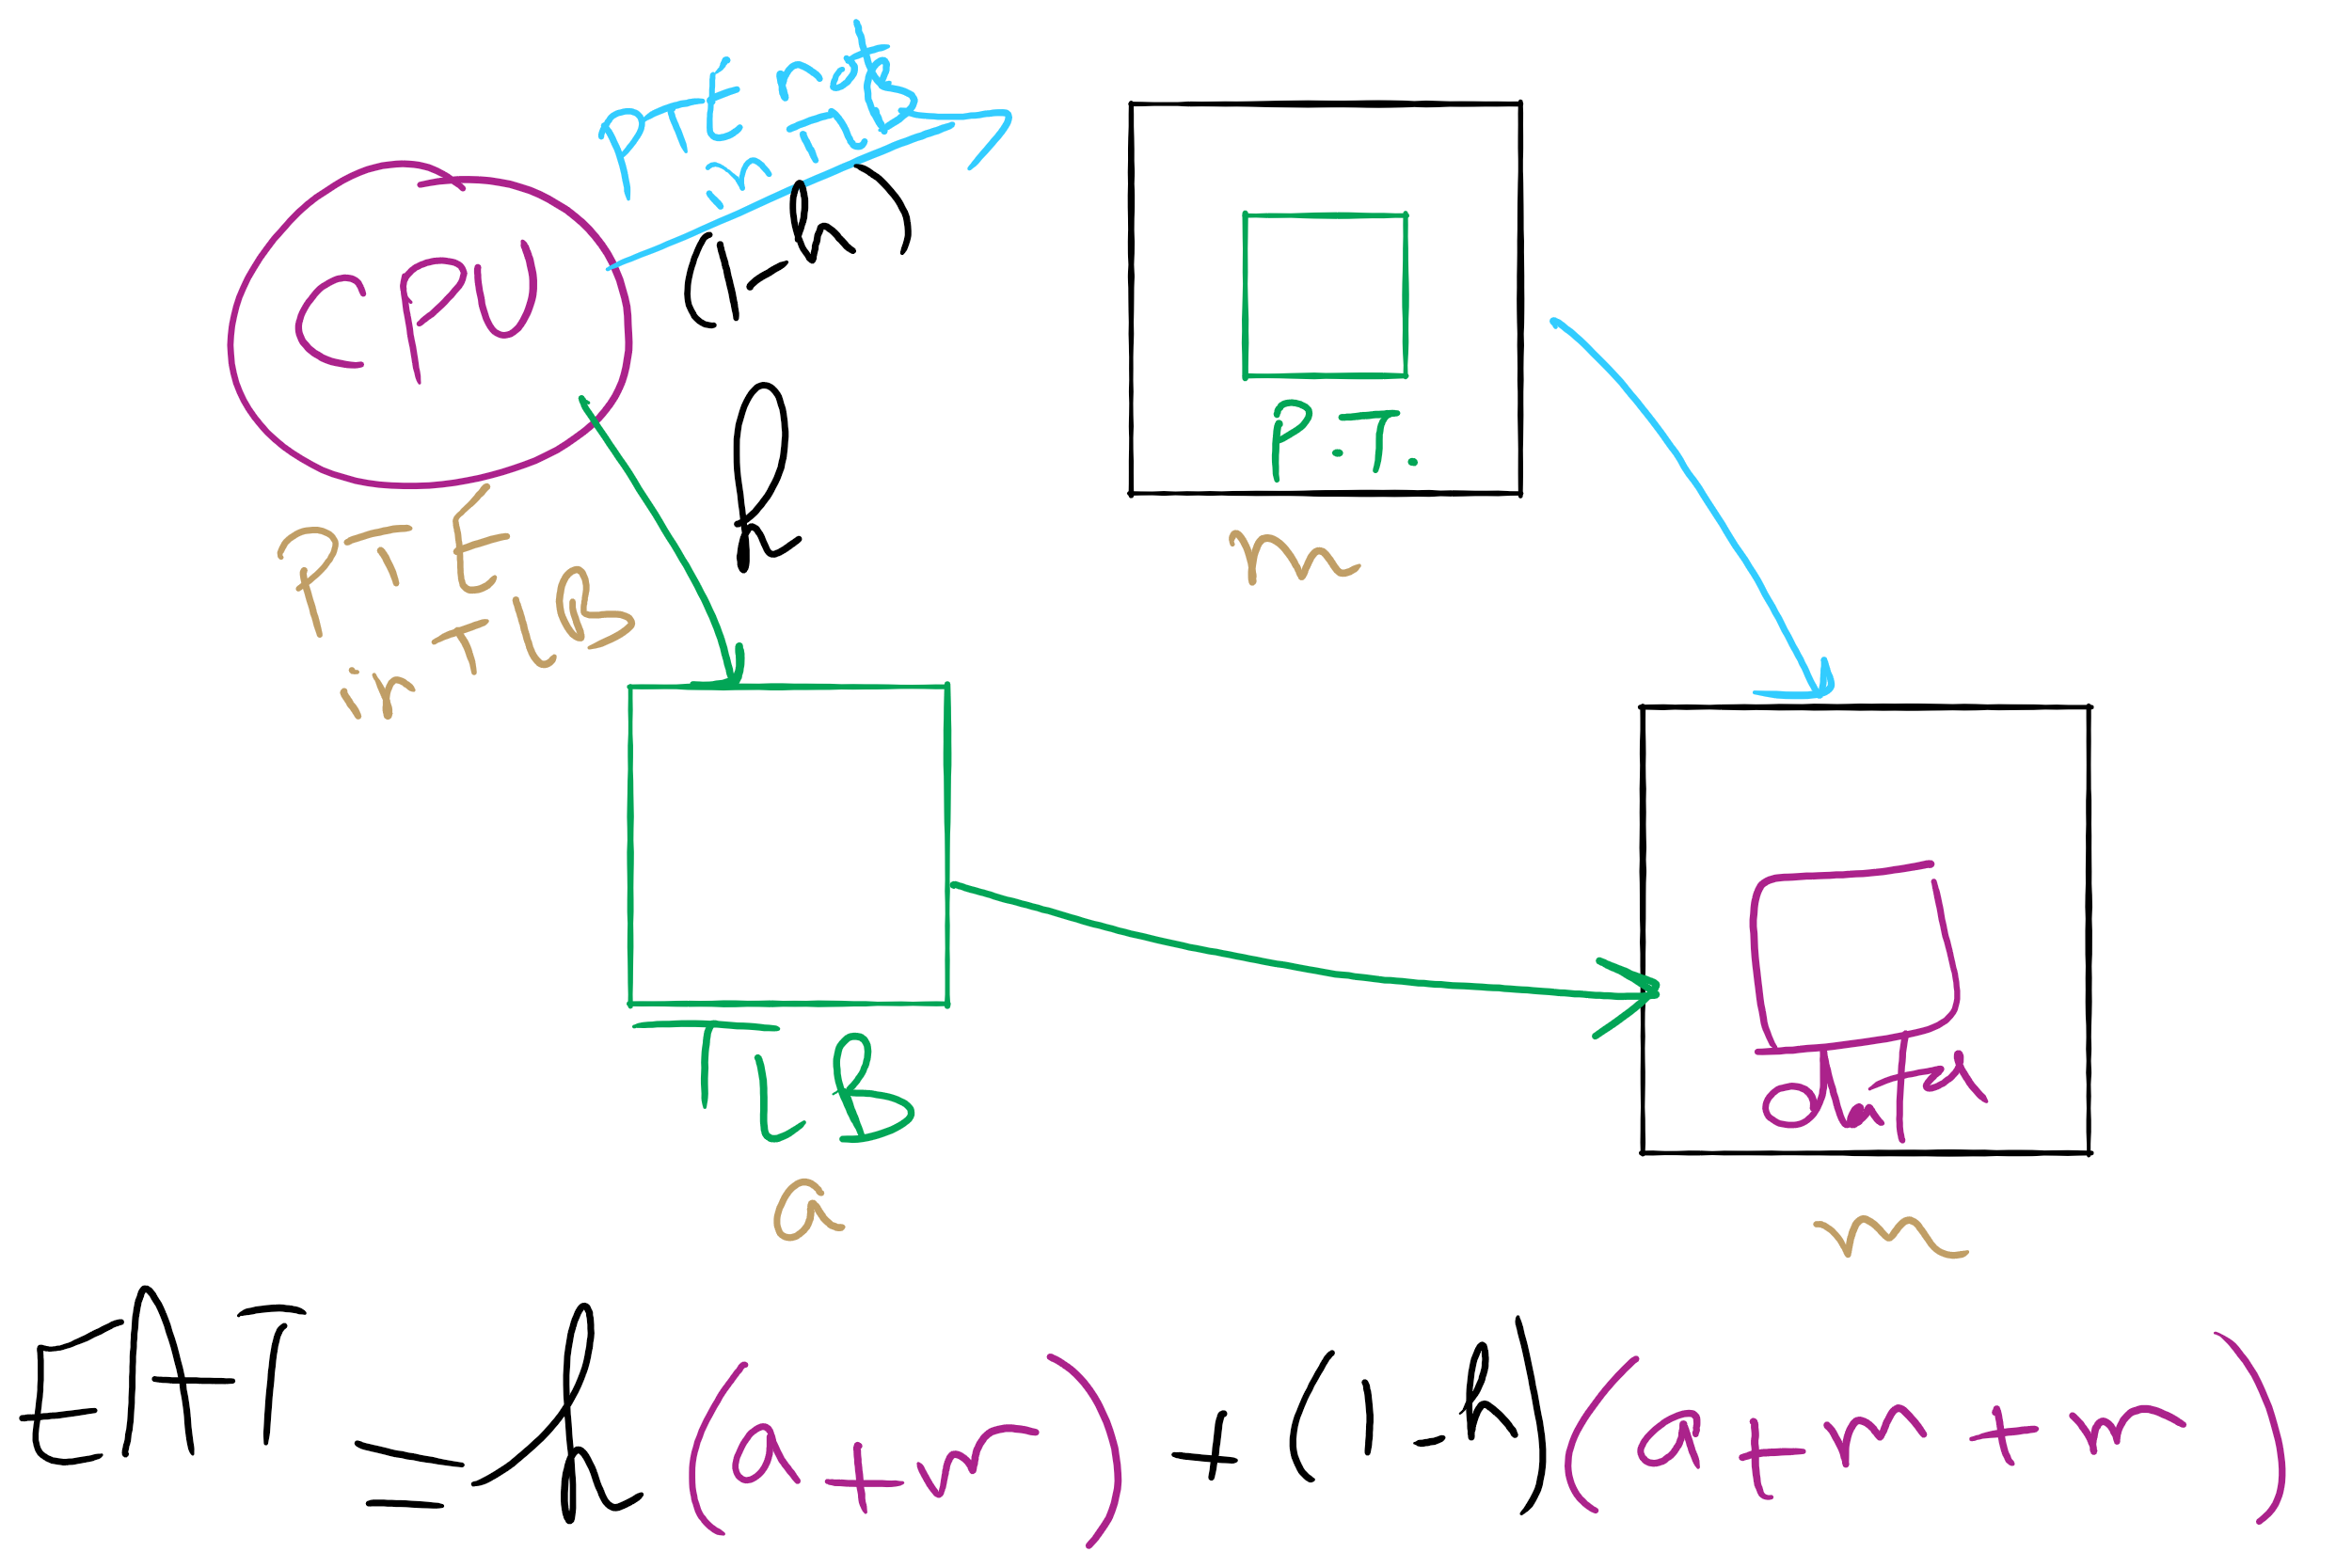
Effective Access Time

Slide 45
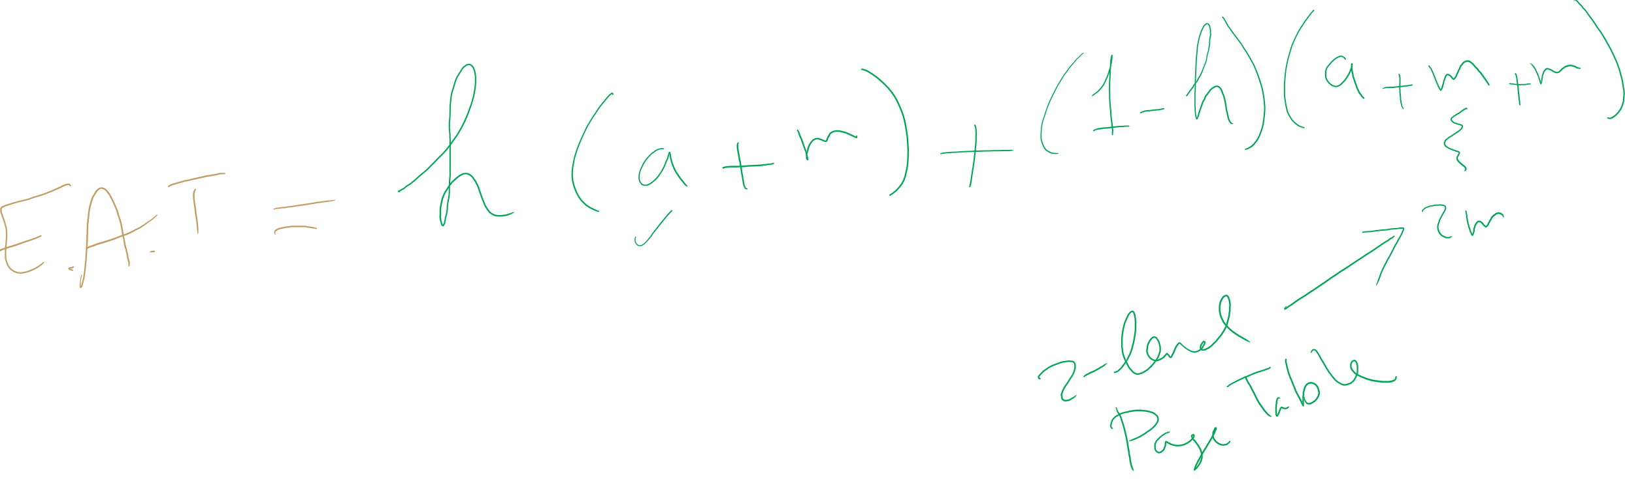
EAT Calculation

Slide 46
Solution 2: Inverted page table
Reduce page table size further: keep one entry for each frame in memory
PTE contains
Virtual address pointing to this frame
Information about the process that owns this page
Search page table by
Hashing the virtual page number and process ID
Starting at the entry corresponding to the hash result
Search until either the entry is found or a limit is reached
Page frame number is index of PTE
Improve performance by using more advanced hashing algorithms

Slide 47
Inverted page table architecture
page number
page offset
process ID
p = 19 bits
offset = 13 bits
Page frame number
0
pid
p
physical address
1
19
13
. . .
search
0
pid₀
p₀
1
pid₁
p₁
. . .
. . .
k
k
pid_{k}
p_{k}
main memory
. . .
inverted page table

Slide 48
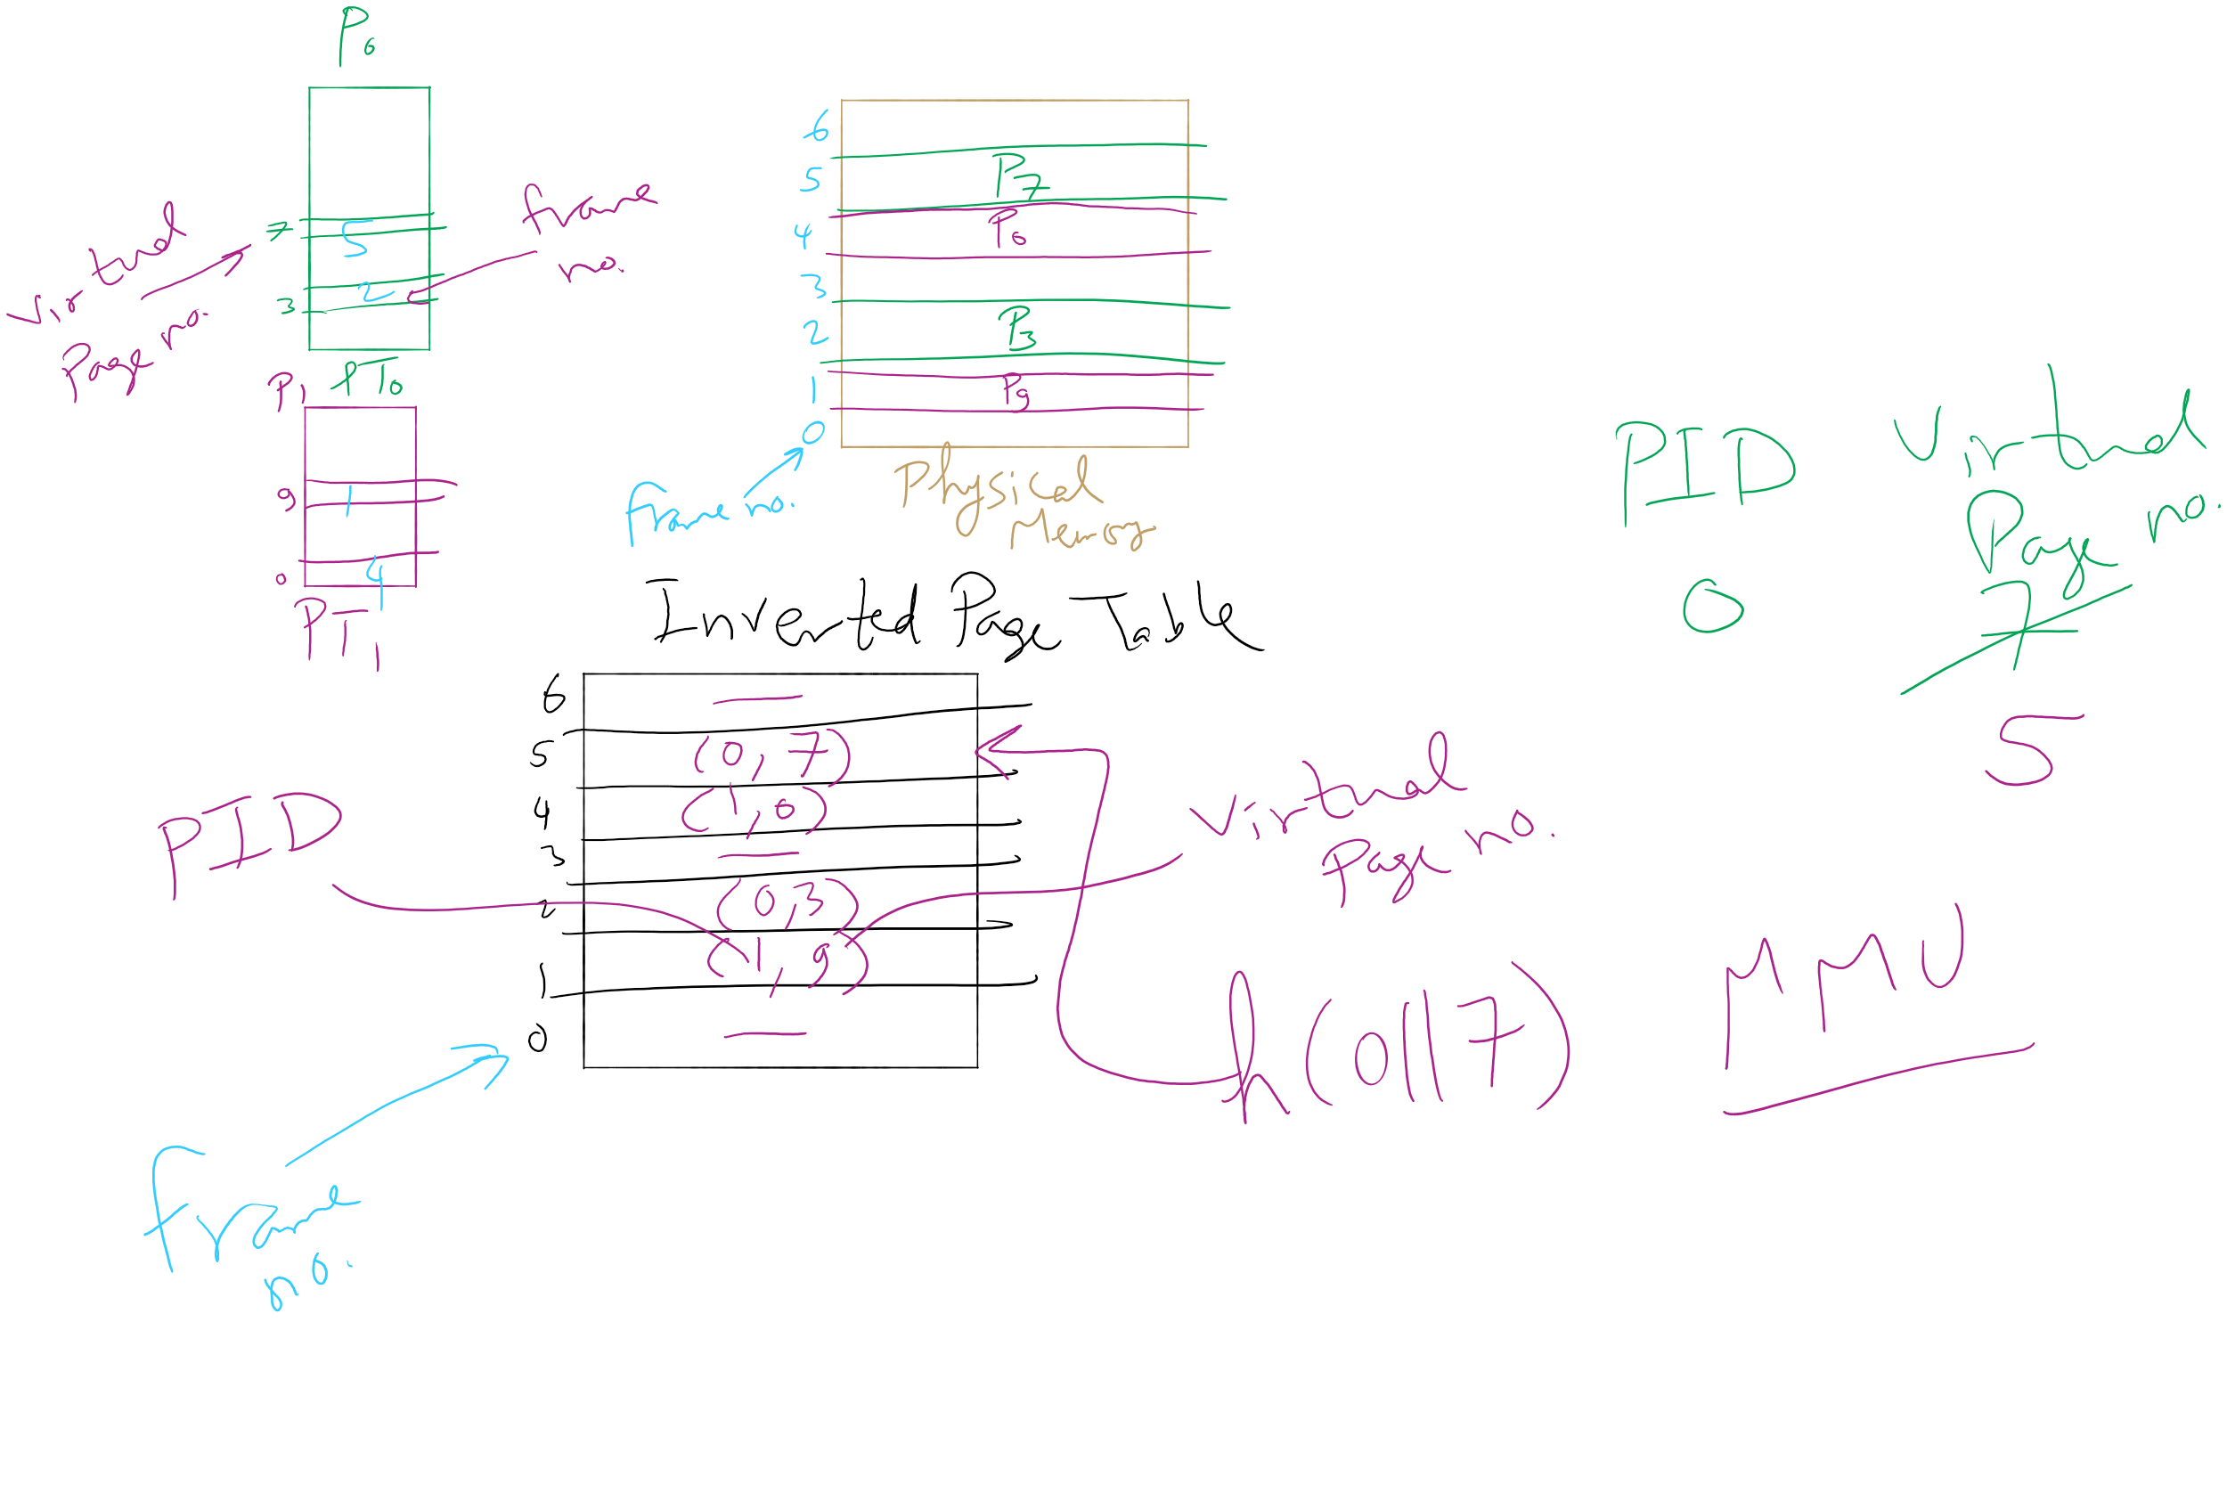
Inverted Page Table Example

